Slide 1

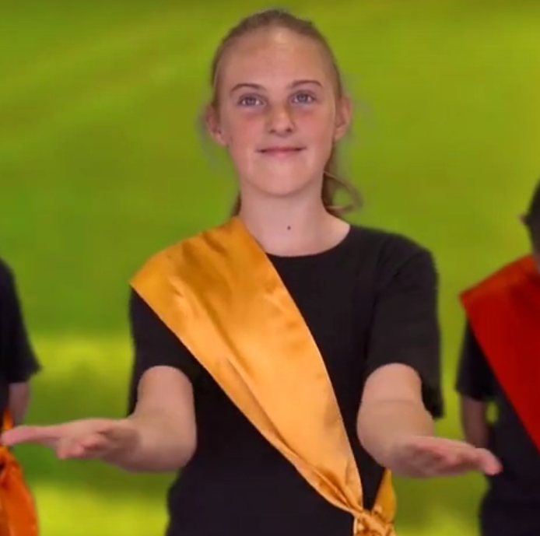


God Be With You As You Go by Andrew Chinn
For all that you are, for the love that you’ve shown
We give thanks to our God, together we have grown
Wherever you are, this you will know
You are in our hearts, God be with you as you go
May God bless you, May God be with you
May God guide you near and far
May God’s love Shine down upon you
And may God’s love dwell in your heart
© Andrew Chinn/Butterfly Music 2014

Slide 2
God Be With You As You Go (2) by Andrew Chinn
On this journey of life, wherever you roam
Know that you are loved, know this as your home
You are in our hearts, a part of you is here
wherever you go, a part of us will be
May God bless you, May God be with you
May God guide you near and far
May God’s love Shine down upon you
And may God’s love dwell in your heart
© Andrew Chinn/Butterfly Music 2014

