Slide 1

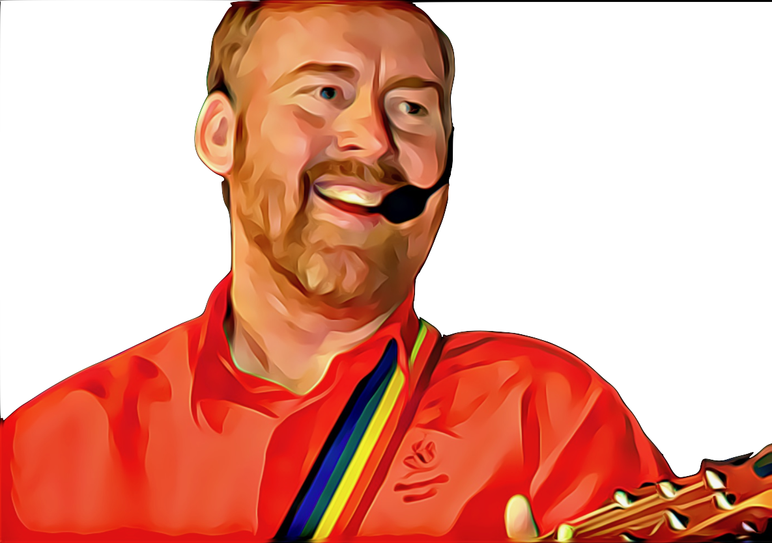
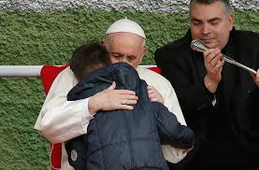

A Father’s Heart, A Mother’s Heart by Andrew Chinn
Wrap your arms around me, share with me your heart
Whisper to me deeply, the yearnings of your soul
For I am always with you, I am never far
My love is ever new, my love does not grow old
With a Father’s heart, I will always love you!
With a Mother’s heart, I will never leave you!
With a Father’s heart, I call you home
With a Mother’s heart, you are my own
© Andrew Chinn/Butterfly Music 2019

Slide 2
A Father’s Heart, A Mother’s Heart (2) by Andrew Chinn
When you wander far from me, when you lose your way
I will not forsake you, wherever you may go
I will seek you always, throughout the night and day
I will be there waiting, I will call you home
With a Father’s heart, I will always love you!
With a Mother’s heart, I will never leave you!
With a Father’s heart, I call you home
With a Mother’s heart, you are my own
© Andrew Chinn/Butterfly Music 2019

Slide 3
A Father’s Heart, A Mother’s Heart (3) by Andrew Chinn
I was always with you, before you first drew breath
I gently held your hand, and watched you grow in love
My heart will be still be with you, at the hour of your death
For I am with you always, I am God’s love
With a Father’s heart, I will always love you!
With a Mother’s heart, I will never leave you!
With a Father’s heart, I call you home
With a Mother’s heart, you are my own
© Andrew Chinn/Butterfly Music 2019

