Slide 1

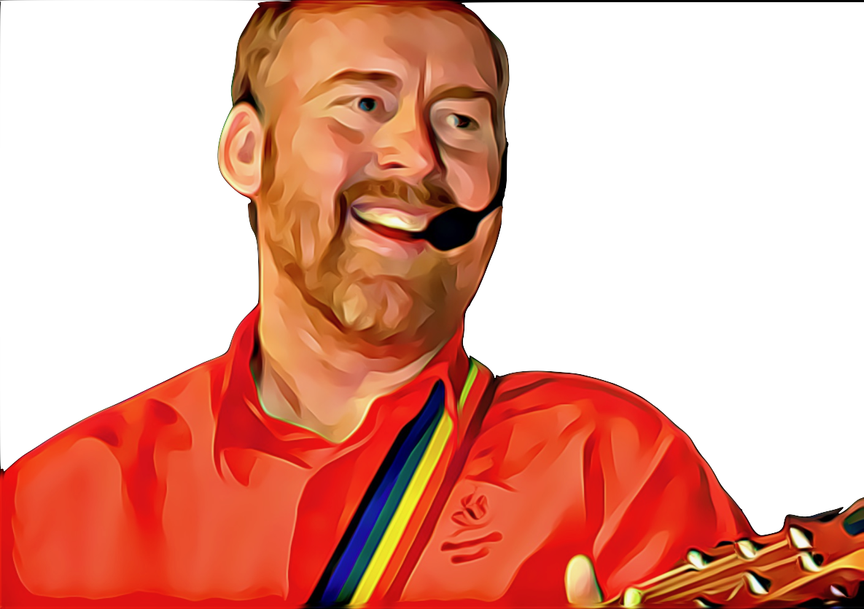


I Light A Candle by Andrew Chinn
I light a candle, I say a prayer
And with Your blessing, Your Spirit’s shared
I light a candle, I say a prayer
And with Your blessing, Your Spirit’s shared
For tender moments, for learning shared
Your light it calls me to love and care
And in your calling, you show the way
I light a candle in Your Name
© Andrew Chinn/Butterfly Music 2009

Slide 2
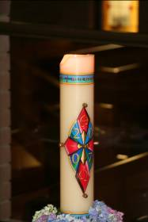
I Light A Candle (2) by Andrew Chinn
I light a candle, I say a prayer
And with Your blessing, Your Spirit’s shared
I light a candle, I say a prayer
And with Your blessing, Your Spirit’s shared
When in the cold, in troubles dark
And in the sadness of our, our deepest heart
In my longing, my darkest day
I light a candle in Your Name
© Andrew Chinn/Butterfly Music 2009

Slide 3
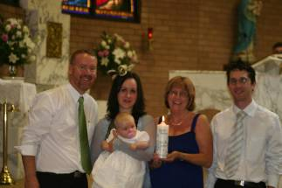
I Light A Candle (3) by Andrew Chinn
I light a candle, I say a prayer
And with Your blessing, Your Spirit’s shared
I light a candle, I say a prayer
And with Your blessing, Your Spirit’s shared
To show the hope, for what could be
To show the love, I take with me
To whisper thanks for all I am
I light a candle in Your name
© Andrew Chinn/Butterfly Music 2009

