Slide 1

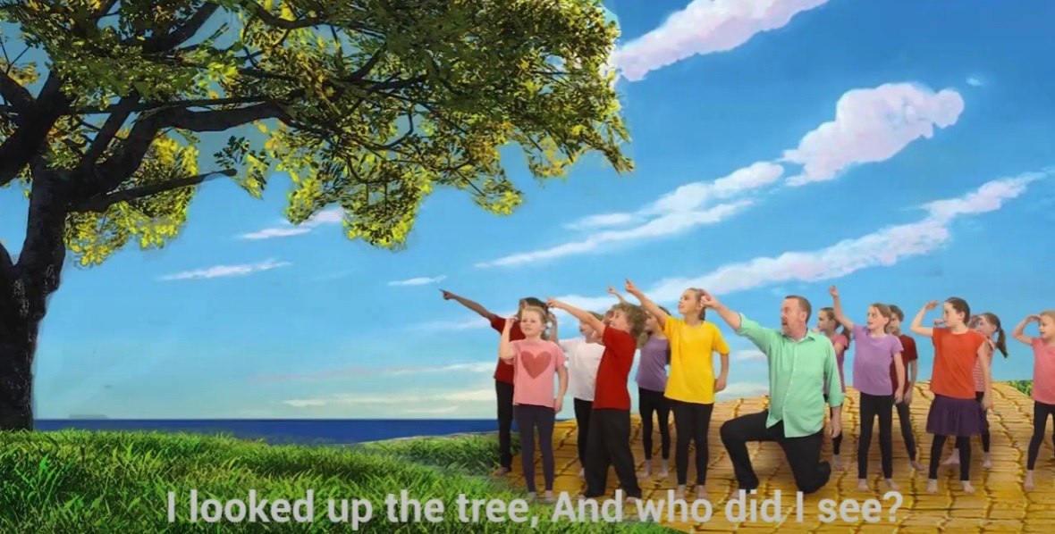


Come And Follow Me by Andrew Chinn
Come and follow me, live in love in peace
Walk along this road with me,
come and be my friend
Come and follow me
I looked out to sea and who did I see?
Peter and the fisherman
They came and followed me
(they came and followed me)
© Andrew Chinn/Butterfly Music 2014

Slide 2
Come And Follow Me (2) by Andrew Chinn
Come and follow me, live in love in peace
Walk along this road with me,
come and be my friend
Come and follow me
I looked up the tree and who did I see?
Zacchaeus in the branches
Come down and follow me
(Come down and follow me)
© Andrew Chinn/Butterfly Music 2014

Slide 3
Come And Follow Me (3) by Andrew Chinn
Come and follow me, live in love in peace
Walk along this road with me,
come and be my friend
Come and follow me
I looked around me and who did I see
All the disciples
They came and followed me
(they came and followed me)
© Andrew Chinn/Butterfly Music 2014

Slide 4
Come And Follow Me (4) by Andrew Chinn
Come and follow me, Live in love in peace
Walk along this road with me,
come and be my friend
Come and follow me
And what about you, will you follow too
Love your God with all your heart
In all you say and do
(in all I say and do)
© Andrew Chinn/Butterfly Music 2014

