Slide 1

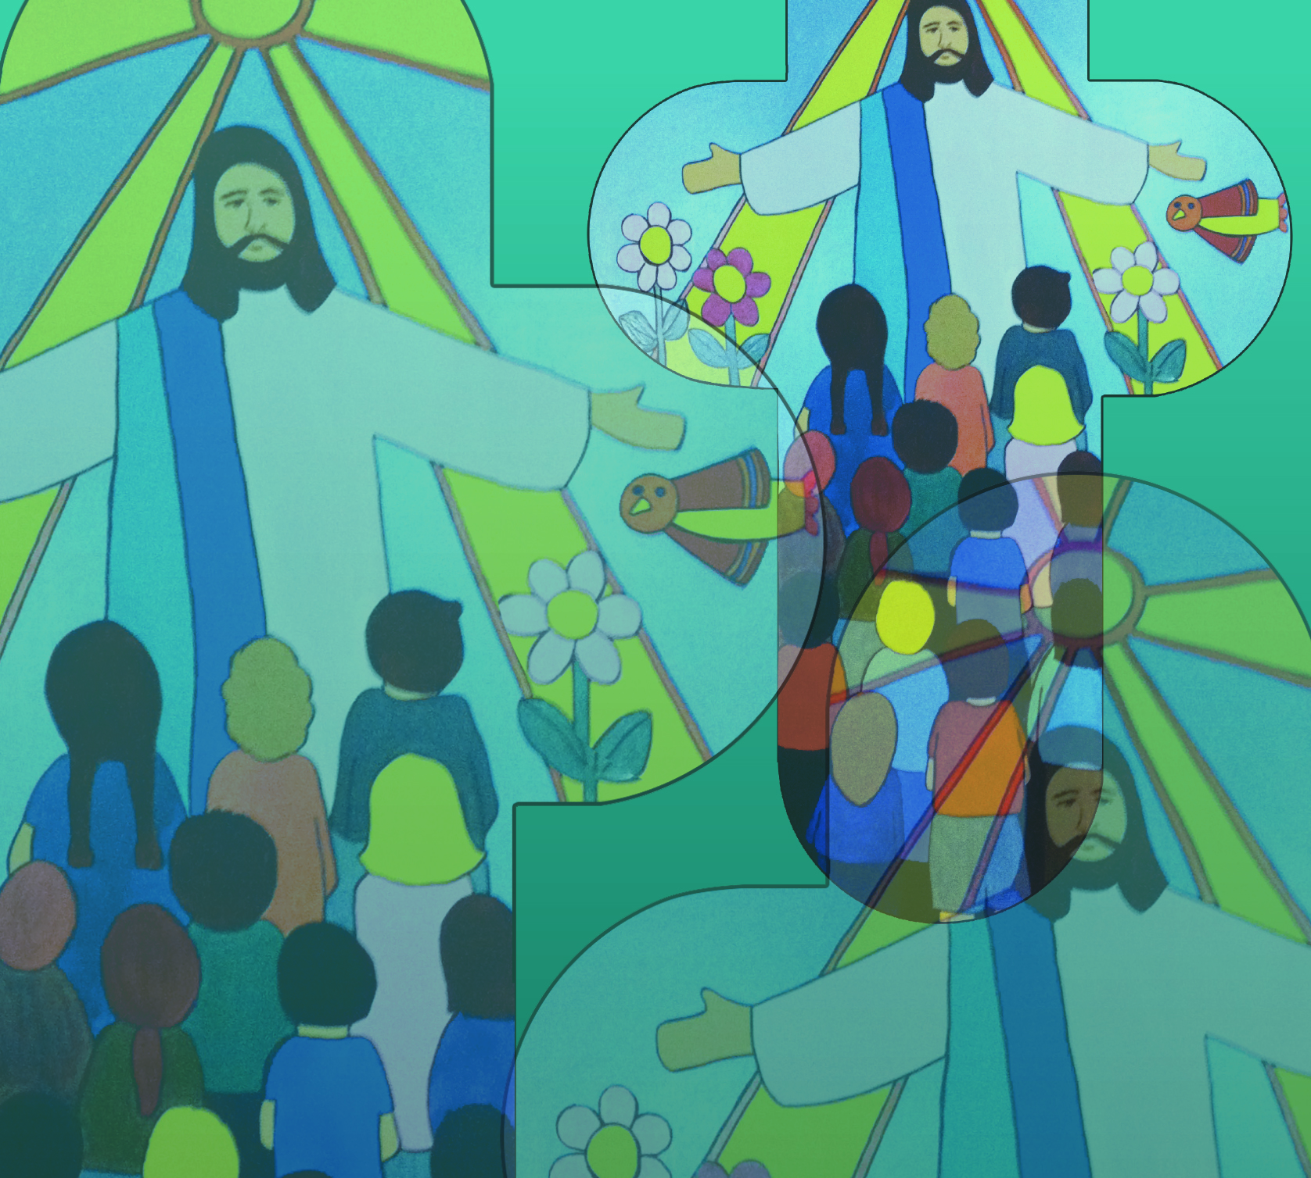

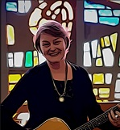
I Believe in You by Jane Mitchell
I believe in you
You are my God
My hope, my strength
Is you alone.
I believe you are here
By my side
You light my way
You lead me home.
© Jane Mitchell 2005

Slide 2
I Believe in You (2)
Oh my God
In your arms I find peace
I am safe
You change my life
Give me hope
I am found.
© Jane Mitchell 2005

Slide 3
I Believe in You (3)
I believe in you
You are my God
My hope, my strength
Is you alone.
I believe you are here
By my side
You light my way
You lead me home.
© Jane Mitchell 2005

Slide 4
I Believe in You (4)
Oh my God
In your arms I find peace
I am safe
You change my life
Give me hope
I am found.
© Jane Mitchell 2005

