Slide 1

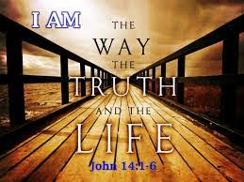


I Am The Way by Andrew Chinn
I am the way, the truth and the life
No one can come unto our God but by me
For our God is Love and God’s love is true
I am the truth and my truth will set you free
Your Word our God is the Word of Truth
A fruit of the Spirit, a fruit of the Light
God is the Spirit, the Spirit lives in you
All grace and truth, come through Jesus Christ
© Andrew Chinn 2009

Slide 2
I Am The Way (2) by Andrew Chinn
I am the way, the truth and the life
No one can come unto our God but by me
For our God is Love and God’s love is true
I am the truth and my truth will set you free
Love one another as I have loved you
And love your God with all your heart and soul
And if you love me, you will do what I ask
Live in God’s love and God will be your home
© Andrew Chinn 2009

Slide 3
I Am The Way (3) by Andrew Chinn
I am the way, the truth and the life
No one can come unto our God but by me
For our God is Love and God’s love is true
I am the truth and my truth will set you free
I am the tree and you are my branches
A tree of life, a tree of truth
Rest in my shade and reach for the heavens
If you rest in me, I will live in you
© Andrew Chinn 2009

