Slide 1


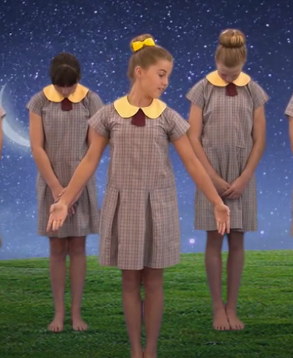

Guide Me Good Shepherd by Andrew Chinn
Guide me Good Shepherd, guide me I pray
Teach me Good Shepherd, lead me in Faith
Walk by my side, help me to grow
Show me your path, your ways I will know
Teach me Good Shepherd in your ways that are true
To love and forgive, to live just like you
Teach me Good Shepherd to be gentle and kind
To live in your love, all the days of my life
© Andrew Chinn 2014

Slide 2
Guide Me Good Shepherd (2) by Andrew Chinn
Guide me Good Shepherd, guide me I pray
Teach me Good Shepherd, lead me in Faith
Walk by my side, help me to grow
Show me your path, your ways I will know
Love me Good Shepherd safe in your arms
In the Spirit of love, One in God’s heart
Love me Good Shepherd and may I love you
In all that I say, in all that I do
© Andrew Chinn 2014

Slide 3
Guide Me Good Shepherd (2) by Andrew Chinn
Guide me Good Shepherd, guide me I pray
Teach me Good Shepherd, lead me in Faith
Walk by my side, help me to grow
Show me your path, your ways I will know
Lead me Good Shepherd, stay by my side
I walk in your footsteps, you are my guide
Lead me Good Shepherd, lead me each day
To live in your light, to follow your way
© Andrew Chinn 2014

