Slide 1

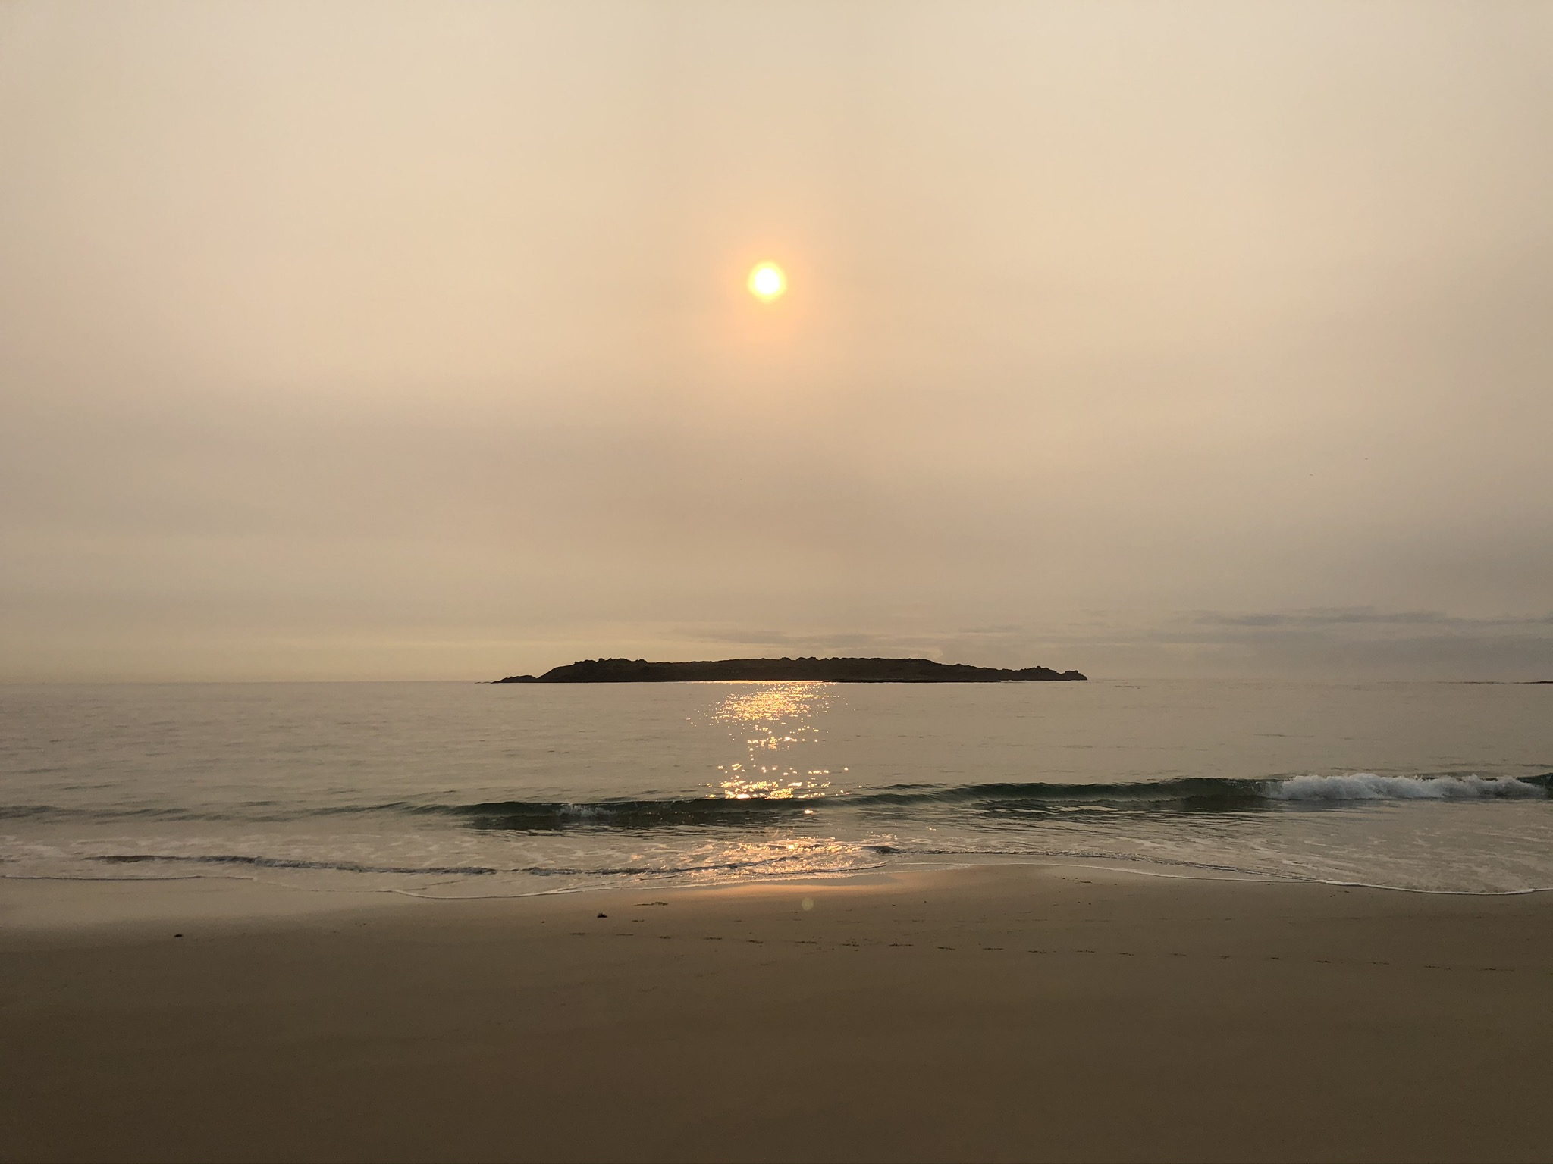


Deep Peace
Deep peace of the running wave to you
Deep peace of the flowing air to you
Deep peace of the quiet air
Deep peace of the shining stars
Deep peace of the Son of Peace to you
© Andrew Chinn/Butterfly Music 2017

