Slide 1

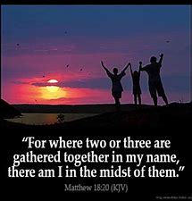

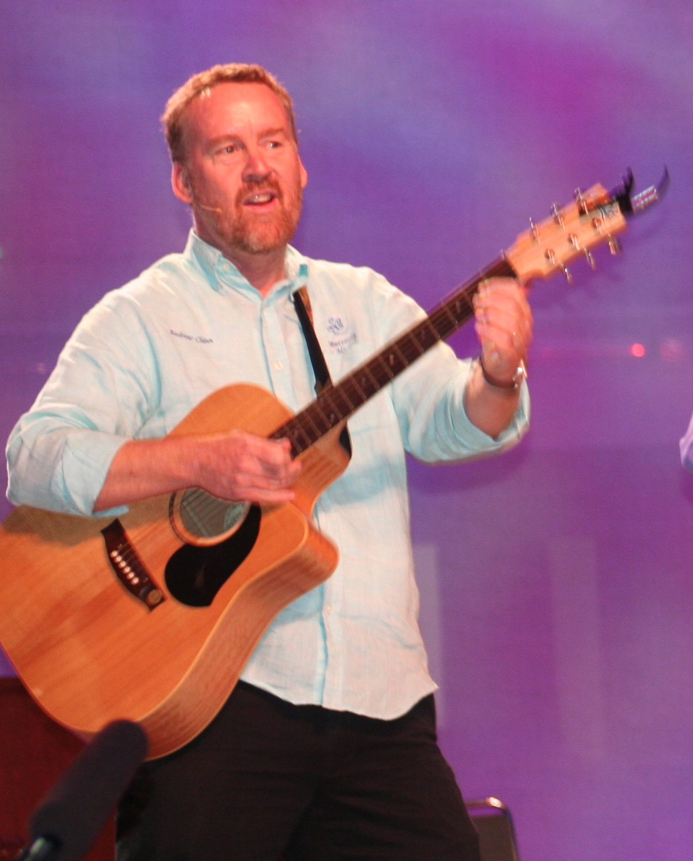
Gathered In My Name by Andrew Chinn
When two or more of you
are gathered in my name
There I will be with you,
gathered in my name
1. Gathered at table,
I will be with you
One bread, one body,
I am with you
© Andrew Chinn/Butterfly Music 2014

Slide 2
Gathered In My Name (2) by Andrew Chinn
When two or more of you
are gathered in my name
There I will be with you,
gathered in my name
2. When bread is broken,
I will be with you
This is my body,
I am with you
© Andrew Chinn/Butterfly Music 2014

Slide 3
Gathered In My Name (3) by Andrew Chinn
When two or more of you
are gathered in my name
There I will be with you,
gathered in my name
3. When cup is shared,
I will be with you
This is my blood,
I am with you
© Andrew Chinn/Butterfly Music 2014

