Slide 1

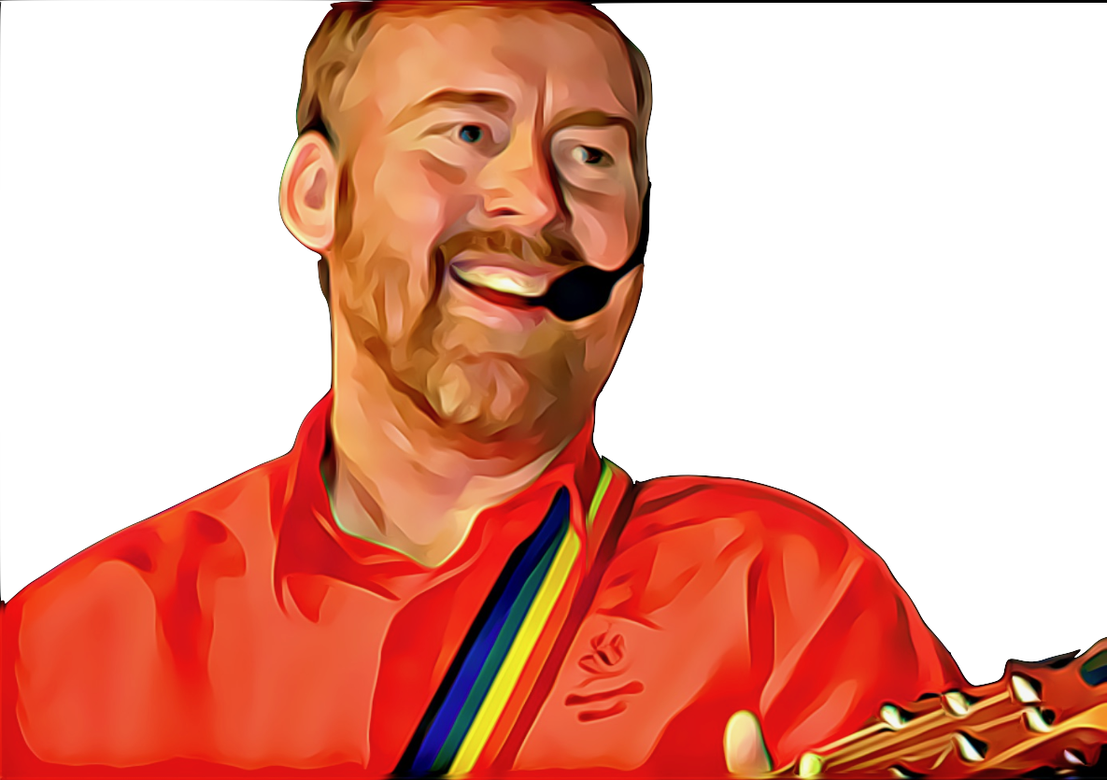
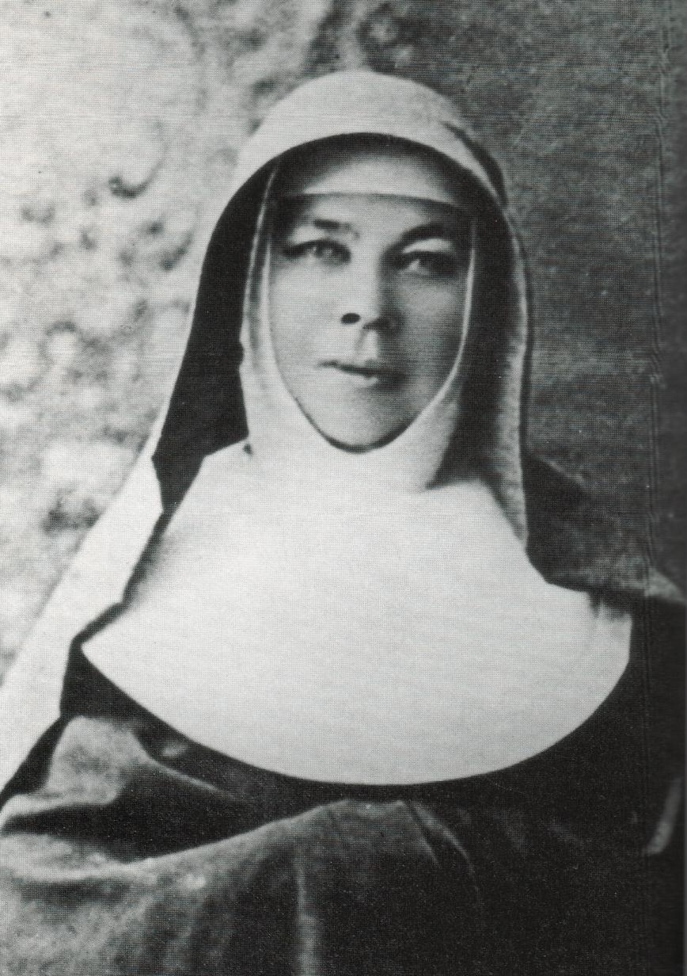

A Cross Of Stars by Andrew Chinn
Across these great lands
She brought the Good News
With courage and love in her heart
That faith and hope and love may live
Beneath a Cross of Stars
Beneath a Cross of Stars
Early in life she heard God’s call
The call of Christ to stand with the poor
To serve like Joseph, to serve in deed
To teach, to love, to answer a need
© Andrew Chinn/Butterfly Music 2004

Slide 2
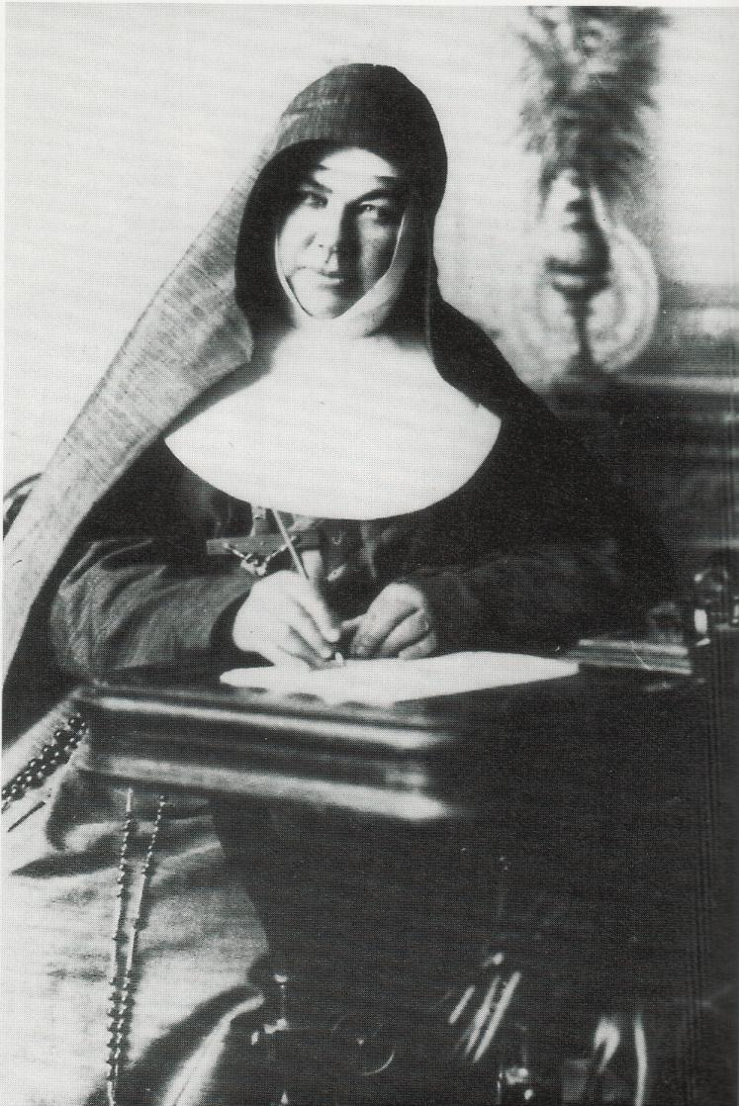
A Cross Of Stars (2) by Andrew Chinn
Across these great lands
She brought the Good News
With courage and love in her heart
That faith and hope and love may live
Beneath a Cross of Stars
Beneath a Cross of Stars
Soon others saw Mary’s shining light
They came from far and they came from wide
To stand with the poor, to teach with the young
To see that Christ’s song would one day be sung
© Andrew Chinn/Butterfly Music 2014

Slide 3
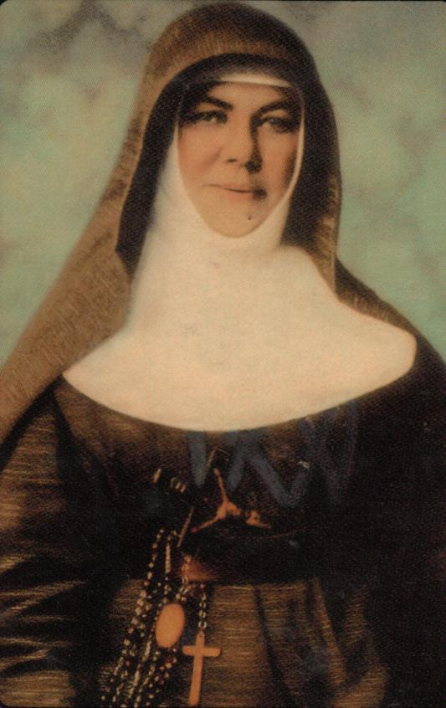
A Cross Of Stars (3) by Andrew Chinn
Across these great lands
She brought the Good News
With courage and love in her heart
That faith and hope and love may live
Beneath a Cross of Stars
Beneath a Cross of Stars
“Have courage no matter what your crosses are”,
This Mary knew when times were hard
She trusted in God, and God did provide
And Mary’s love travelled far and wide
© Andrew Chinn/Butterfly Music 2014

Slide 4
A Cross Of Stars (4) by Andrew Chinn
Across these great lands
She brought the Good News
With courage and love in her heart
That faith and hope and love may live
Beneath a Cross of Stars
Beneath a Cross of Stars
Across a vast land from north to south
And to the land of the Long White Cloud
She carried her dream, she followed her call
So that our faith would live in us all
© Andrew Chinn/Butterfly Music 2014

