Slide 1

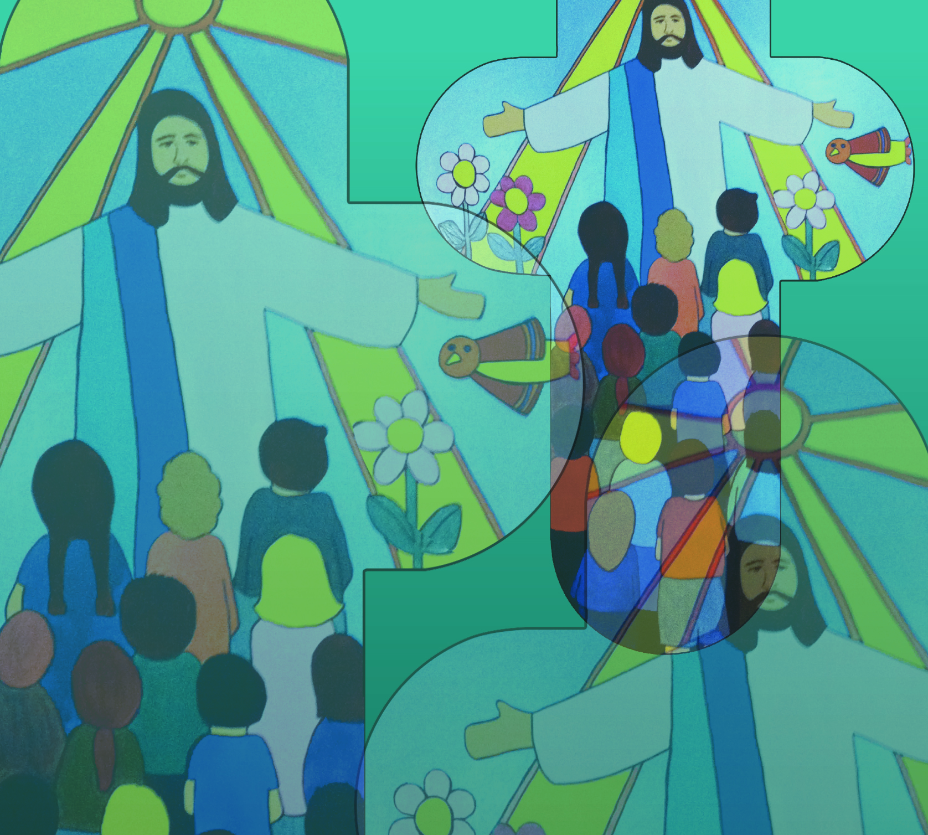

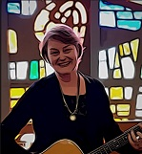
God’s Word by Jane Mitchell
May God’s word be in my thoughts
May God’s word be on my lips
May God’s word ever and always be in my heart
© Jane Mitchell 2011

Slide 2
God’s Word (2)
Alleluia Verse Spoken
© Jane Mitchell 2011

Slide 3
God’s Word (3)
May God’s word be in my thoughts
May God’s word be on my lips
May God’s word ever and always be in my heart
This is my prayer
This is my prayer
That the word of God defines my life this is my prayer
© Jane Mitchell 2011

