Slide 1

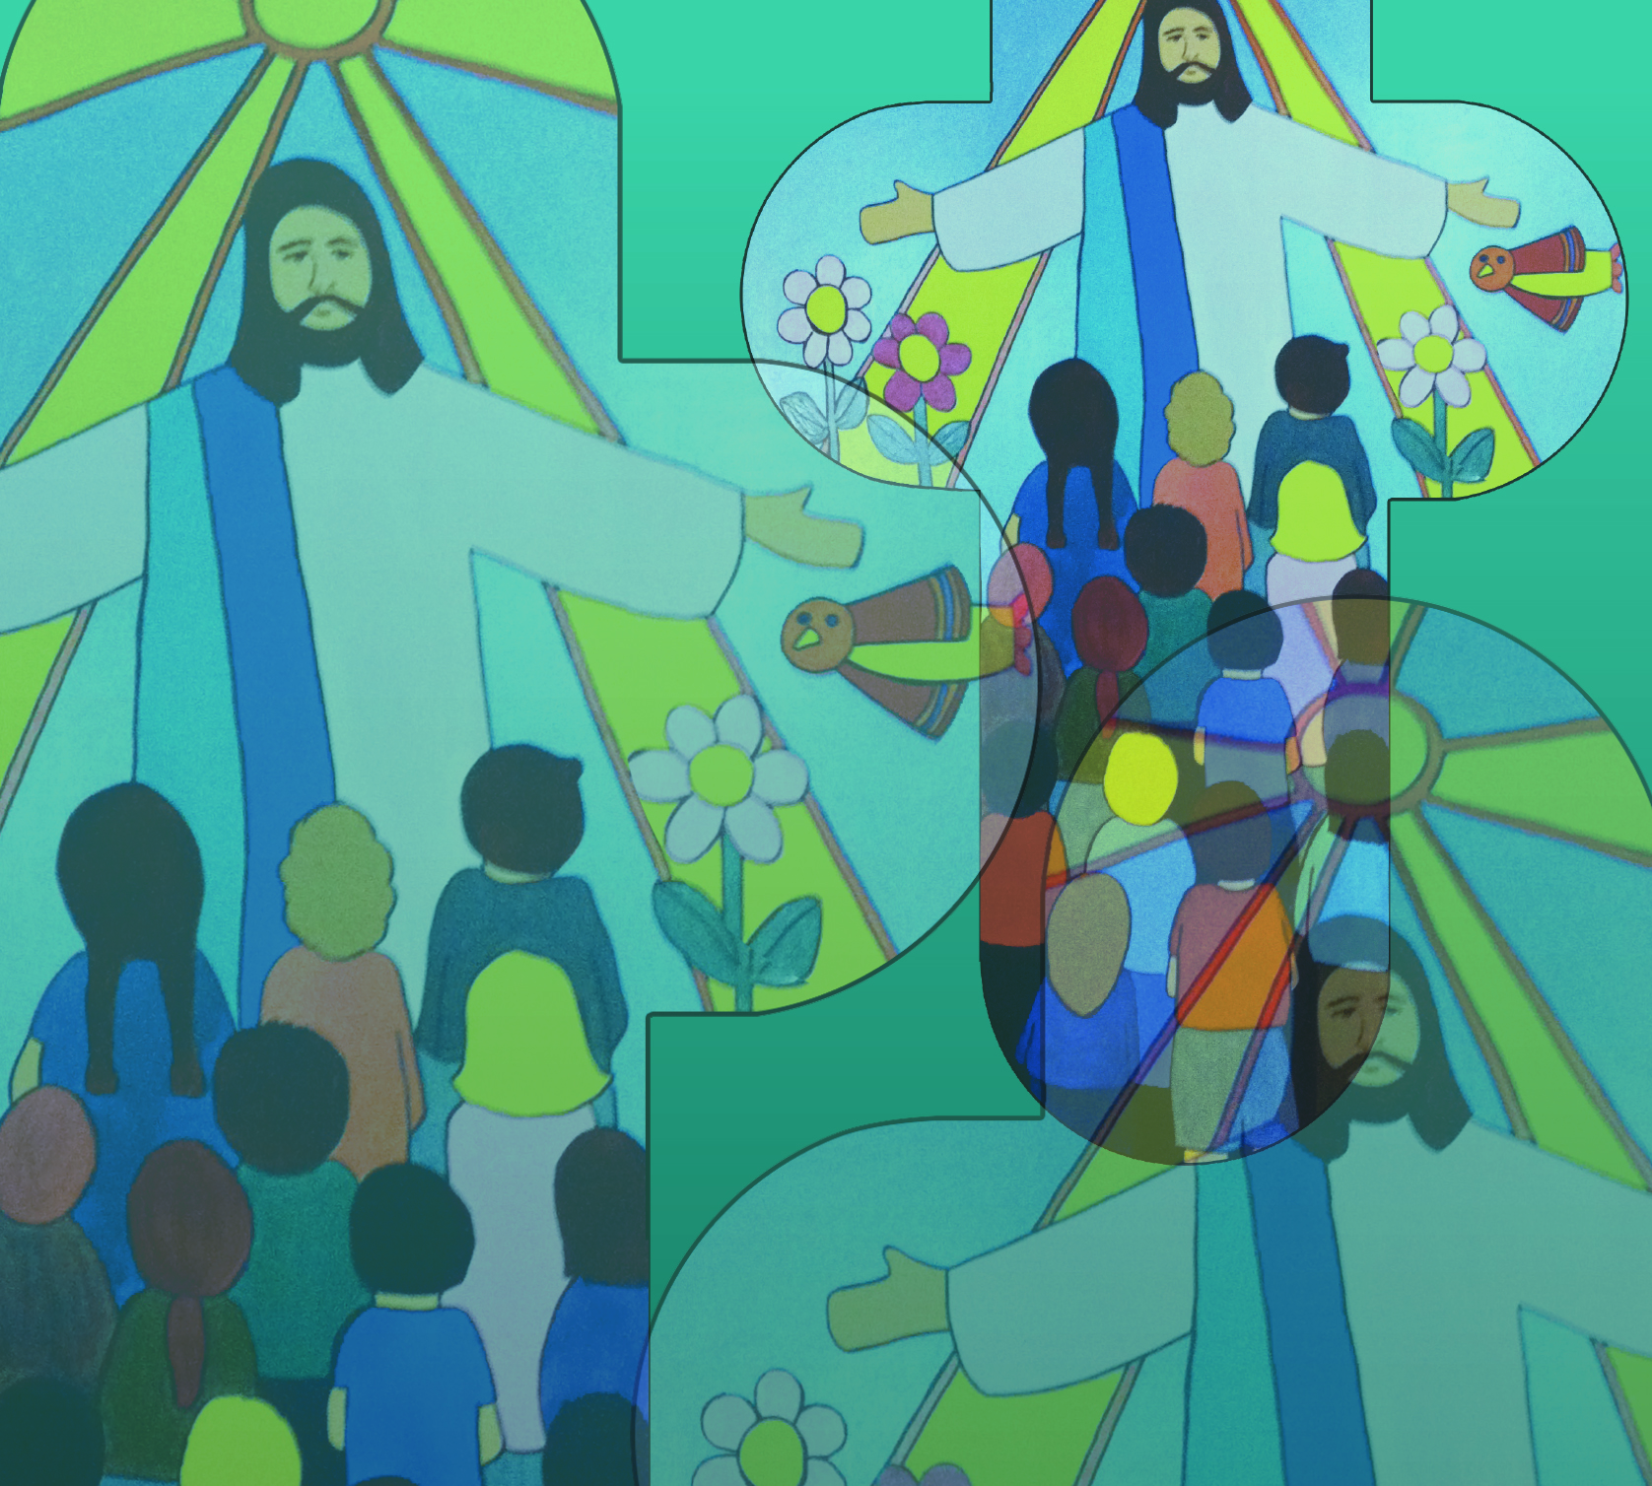

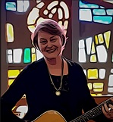
Celebrate – Shepherd by Jane Mitchell
Welcome to our celebration
come and join the congregation
Lift your voice x x x
Clap your hands x x x
Sing your praise to God
Sing your praise to God
© Jane Mitchell 2011

Slide 2
Celebrate – Shepherd (2)
God our loving Shepherd
Showing us the way
Guiding us with tenderness
With us every day!
© Jane Mitchell 2011

Slide 3
Celebrate – Shepherd (3)
Welcome to our celebration
come and join the congregation
Lift your voice x x x
Clap your hands x x x
Sing your praise to God
Sing your praise to God
© Jane Mitchell 2011

