Slide 1

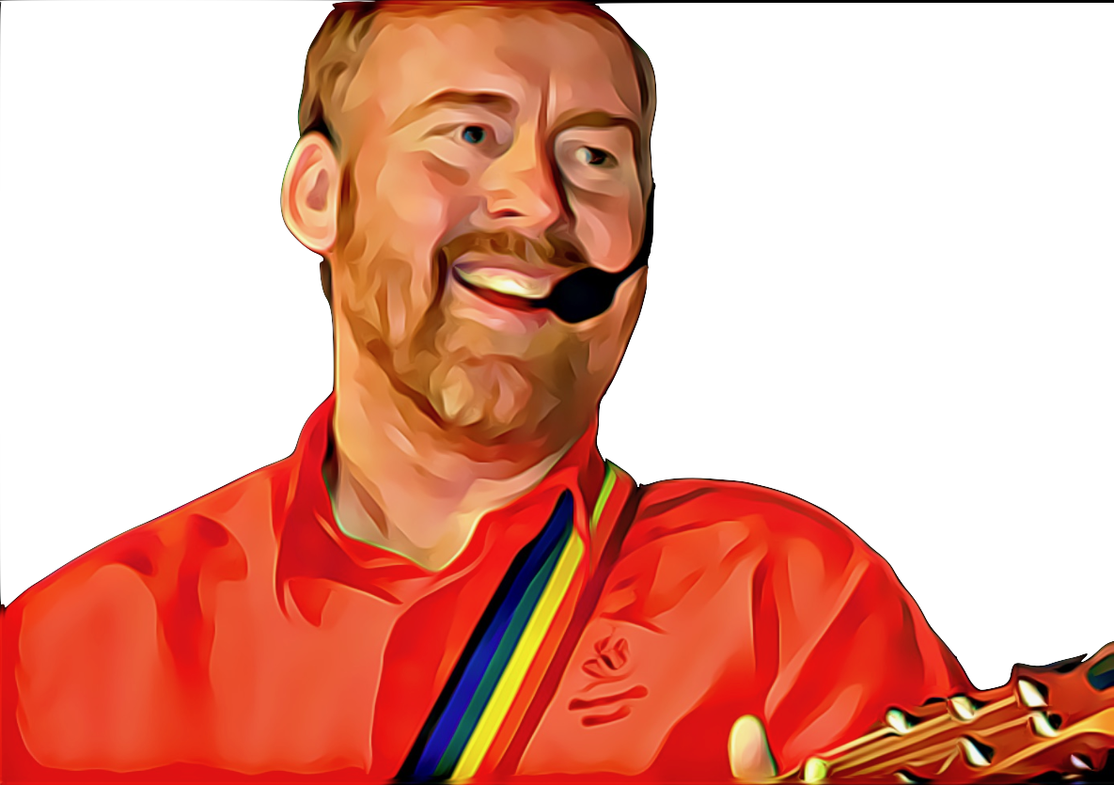

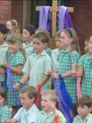

Bless Our King by Andrew Chinn
1. Jesus walked to Jerusalem
His friends were by his side
He said to two "Go ahead my friends
where you'll find a donkey tied
Untie the donkey and bring it here,
if anyone asks you why
Tell them, my friends,
the Master calls and on it I will ride”
Hosanna! Hosanna! Hosanna! Bless our King!
Hosanna! Hosanna! Hosanna! Bless our King!
© Andrew Chinn/Butterfly Music 2000

Slide 2
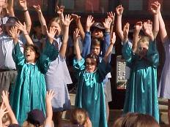
Bless Our King (2) by Andrew Chinn
2. So they did as he asked and led it there
and placed their coats on its back
And helped their friend to climb on top
and led him down the track
They walked together along the track
The crowd began to grow
With waving palms and singing hearts,
their joy they came to show
Hosanna! Hosanna! Hosanna! Bless our King!
Hosanna! Hosanna! Hosanna! Bless our King!
© Andrew Chinn/Butterfly Music 2000

Slide 3
Bless Our King (3) by Andrew Chinn
3. God bless our King who comes today
and walks in the name of our God
God bless our King who comes today
and walks in the name of our God
Hosanna! Hosanna! Hosanna! Bless our King!
Hosanna! Hosanna! Hosanna! Bless our King!
© Andrew Chinn/Butterfly Music 2000

