Slide 1

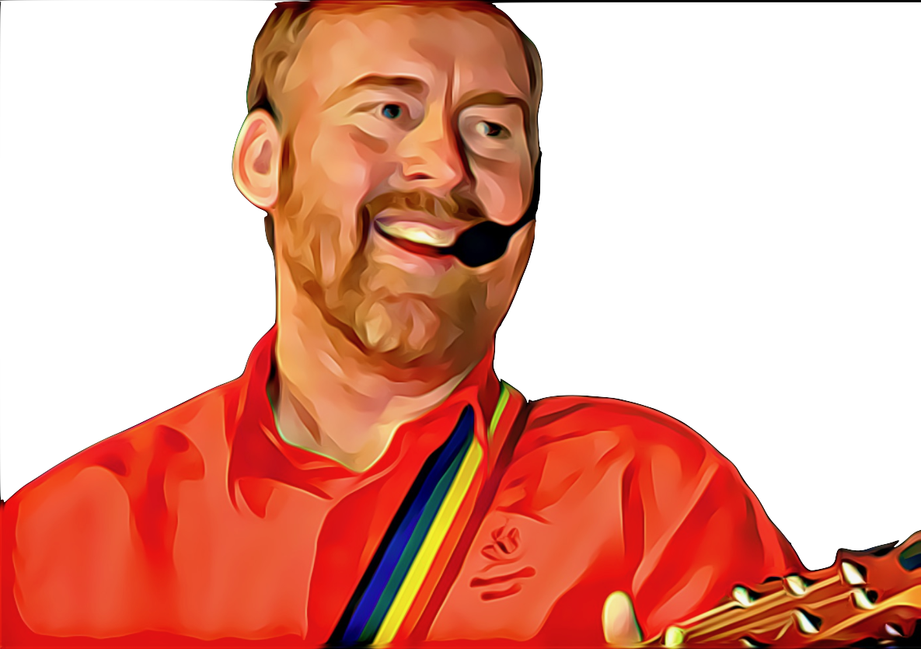
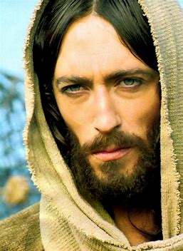

In The Footsteps of Jesus by Andrew Chinn
In the footsteps of Jesus we follow on your way
As we walk on your path of love and hope and faith
We journey together each day as we grow
In the love of our God, wherever we go
1. God sent us Jesus, to show us the way
To follow in his love as we grow each day
To walk in the light, to walk in the truth
In all we say and all we do
© Andrew Chinn/Butterfly Music 2007

Slide 2
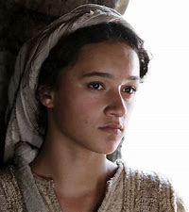
In The Footsteps of Jesus (2) by Andrew Chinn
In the footsteps of Jesus we follow on your way
As we walk on your path of love and hope and faith
We journey together each day as we grow
In the love of our God, wherever we go
2. God gave us Mary, as mother for all
She gave her life to follow God’s call
Walk in God’s love, walk in God’s peace
Walk with our God humbly
© Andrew Chinn/Butterfly Music 2007

Slide 3
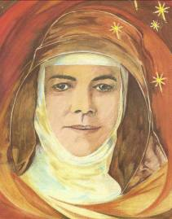
In The Footsteps of Jesus (3) by Andrew Chinn
In the footsteps of Jesus we follow on your way
As we walk on your path of love and hope and faith
We journey together each day as we grow
In the love of our God, wherever we go
3. Here in this great land, another heard the call
To reach out to others, to teach the poor
Reach out in love, reach out in deed
To answer a call from those in need
© Andrew Chinn/Butterfly Music 2007

Slide 4
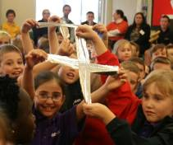
In The Footsteps of Jesus (4) by Andrew Chinn
In the footsteps of Jesus we follow on your way
As we walk on your path of love and hope and faith
We journey together each day as we grow
In the love of our God, wherever we go
4. Here in our own hearts we hear the call too
The call of Jesus for me and for you
One in our God, one in God’s call
A family of love, with love for all
© Andrew Chinn/Butterfly Music 2007

