Slide 1

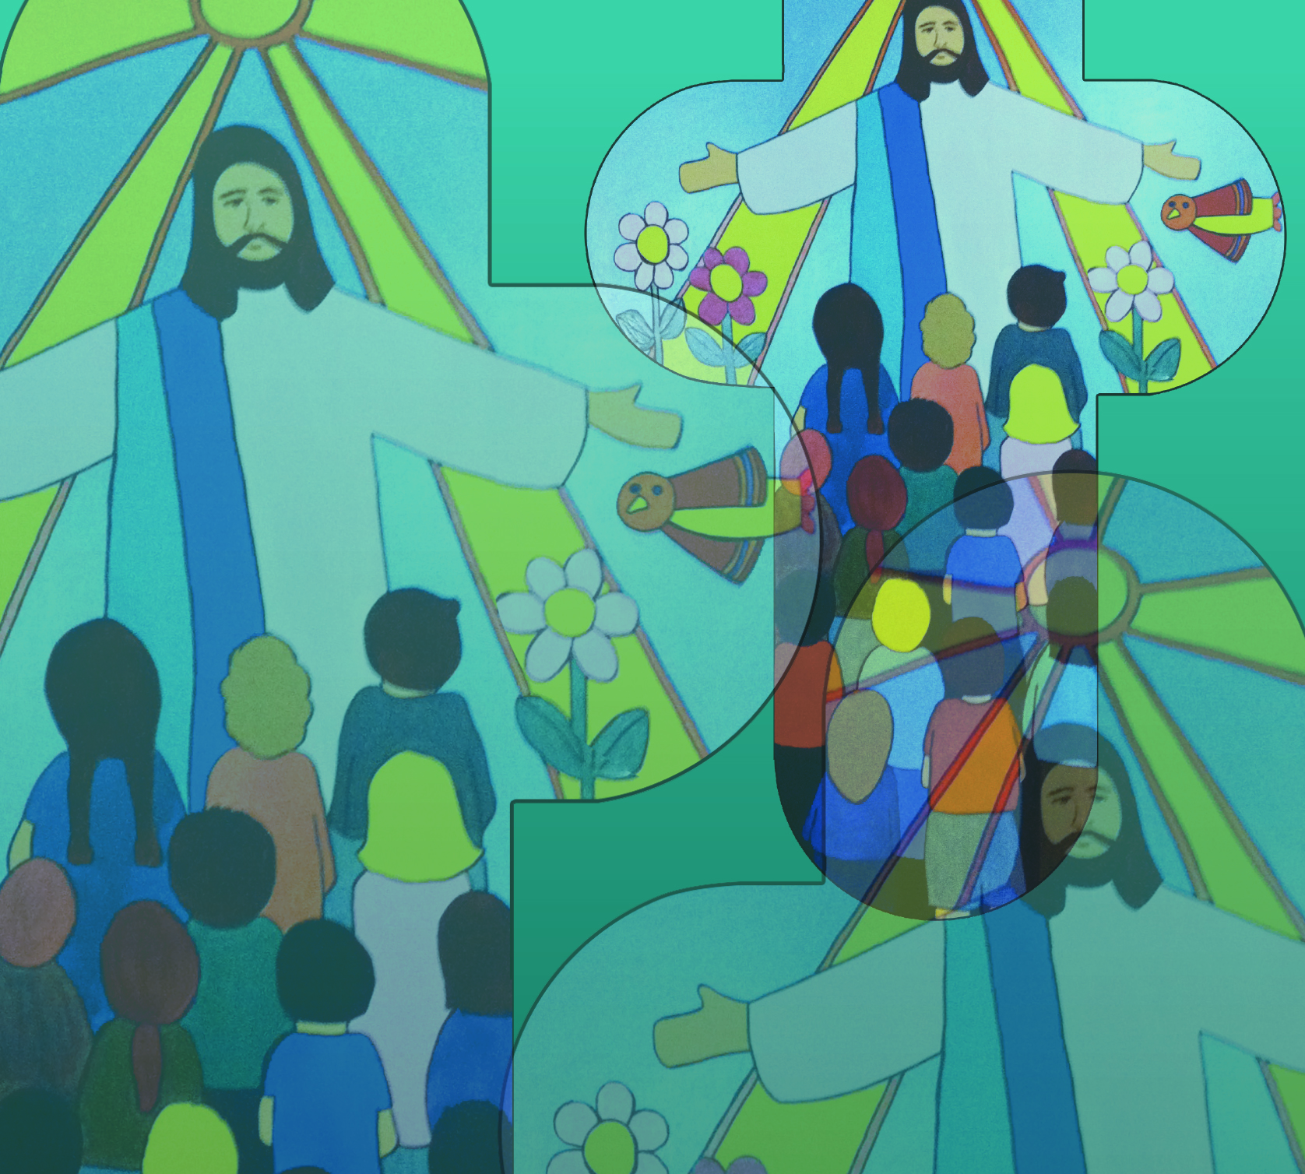


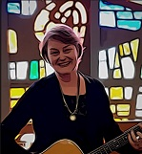
Celebrate – Mary by Jane Mitchell
Welcome to our celebration
come and join the congregation
Lift your voice x x x
Clap your hands x x x
Sing your praise to God
Sing your praise to God
© Jane Mitchell 2011

Slide 2
Celebrate – Mary (2)
Today we honour Mary
Mother of our God
Lift your voices sing her praise
She is blessed by God!
© Jane Mitchell 2011

Slide 3
Celebrate – Mary (3)
Welcome to our celebration
come and join the congregation
Lift your voice x x x
Clap your hands x x x
Sing your praise to God
Sing your praise to God
© Jane Mitchell 2011

