Slide 1

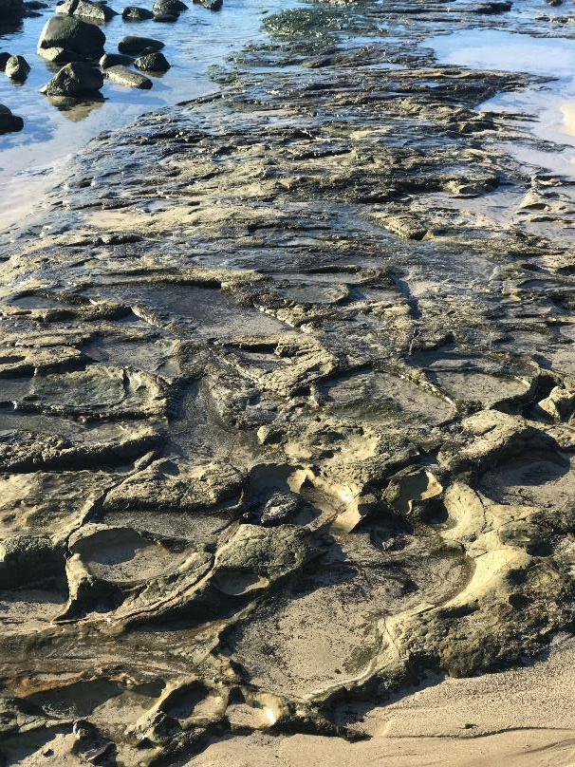

Aboriginal Lord’s Prayer sung by Andrew Chinn
1. You are our Father, you live in heaven
We talk to you, Father you are good (repeat)
2. We believe your word, Father
We are children, give us bread today (repeat)
3. We have done wrong, we are sorry
Help us Father not to sin again (repeat)
© Diocese of Broome

Slide 2
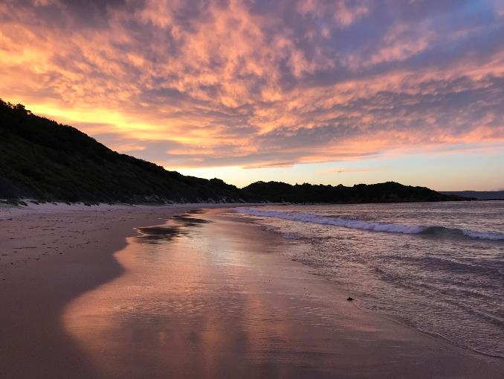
Aboriginal Lord’s Prayer (2) by Andrew Chinn
4. Others have done wrong to us
And we are sorry for them, Father today (repeat)
5. Help us from doing wrong, Father
Save us all from the evil one (repeat)
You are our Father, you live in heaven
We talk to you, Father you are good (repeat)
© Diocese of Broome

