Slide 1


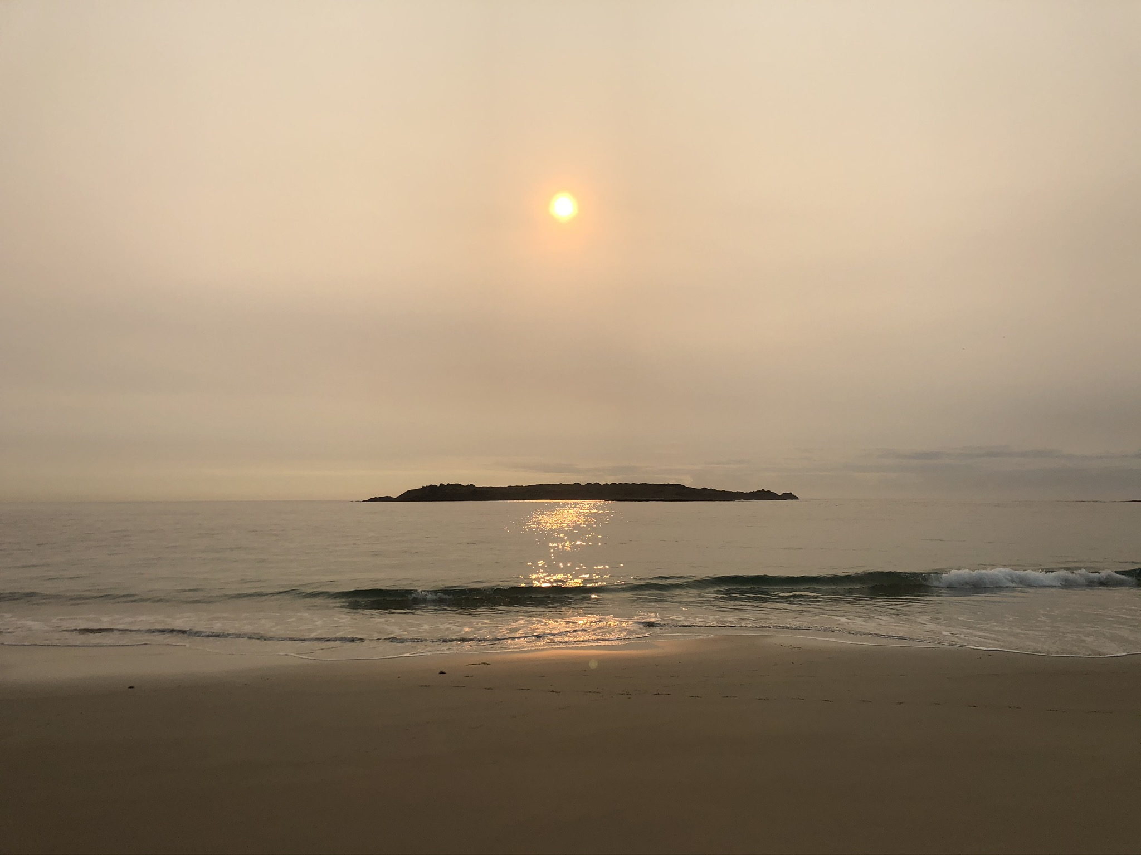

An Australian Blessing by Andrew Chinn
May the God of the sun, gently rising
Bring the hope of a day just begun
May the God of the oceans all around us
Bring you the peace of the Holy One
May the God of the desert, heart of our land
Bring the stillness and silence of the wise
May the God of the rivers, flowing freely
Bring new hope, soothing calm, and new life
© Andrew Chinn/Butterfly Music 2017

Slide 2
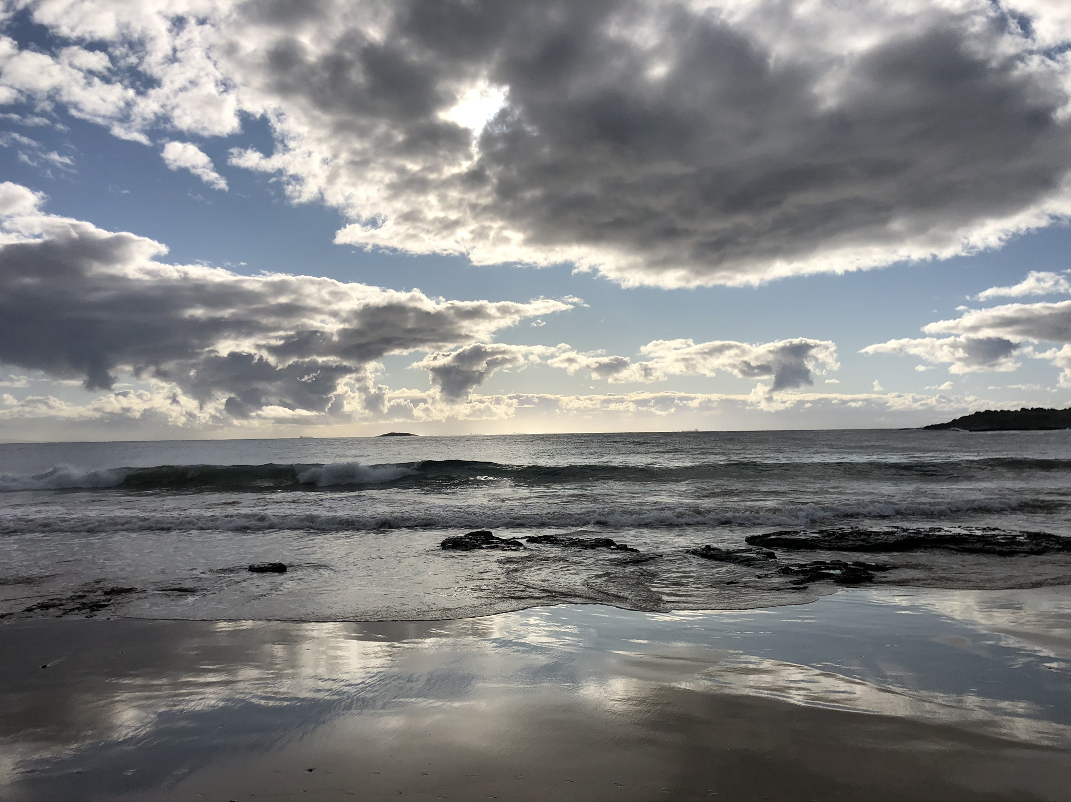
An Australian Blessing (2) by Andrew Chinn
May the God of blue skies above us
Lift your heart and bring you joy
May the God of the rains from the heavens
Nurture you and soothe your soul
May the God of the sun, gently setting
Bring you peace and rest your weary heart
May the God of the stars of our Southern Cross
Shine down on you wherever you are
Shine down on you wherever you are
© Andrew Chinn/Butterfly Music 2017

