Slide 1


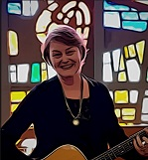

Calling
By Jane Mitchell
On the wind I hear you calling,
“Follow me, follow me”
On the wind…
Follow me
A voice cries out from the wilderness,
“Repent, God is near.”
© Jane Mitchell

