Slide 1

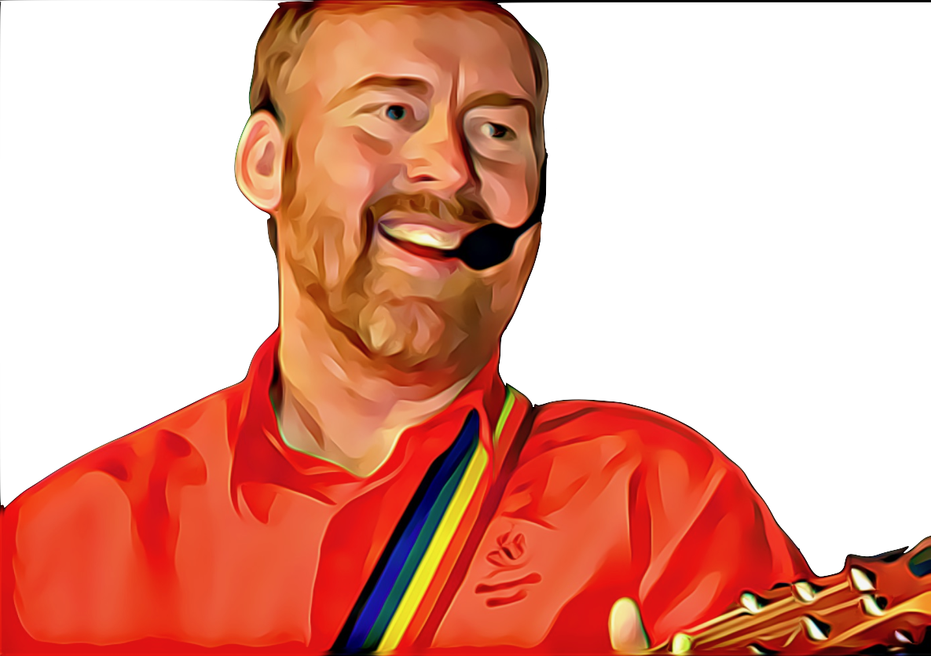



Always Faithful, Ever True by Andrew Chinn
Always faithful, ever true
Christ at the heart of all that we do
Like the shamrock together we’re one
One in our faith, One in God’s love
Like St Patrick we are called to our God
To have faith in our self to grow in God’s love
To be all we can be, to learn all life long
Together we pray, together we’re strong
© Andrew Chinn/Butterfly Music 2019

Slide 2
Always Faithful, Ever True (2) by Andrew Chinn
Always faithful, ever true
Christ at the heart of all that we do
Like the shamrock together we’re one
One in our faith, One in God’s love
Like St Patrick we are called to God’s Son
To have faith in each other, To live in Christ’s love
We reach out in love to all sisters and brothers
And so we are called to love one another
© Andrew Chinn/Butterfly Music 2019

Slide 3
Always Faithful, Ever True (3) by Andrew Chinn
Always faithful, ever true
Christ at the heart of all that we do
Like the shamrock together we’re one
One in our faith, One in God’s love
Like St Patrick we are called to be one
One Faith in the Spirit, Father and Son
God in our hearts, God with us always
To live in our faith, all our lives, all our days
© Andrew Chinn/Butterfly Music 2019

