Slide 1

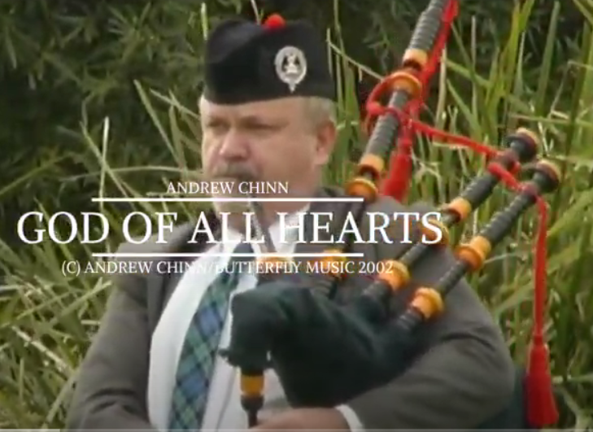


God Of All Hearts by Andrew Chinn
God of justice, God of truth
God of wonder, God of faith
God of mercy, God of all time
God of all hearts, God of mine
1. I was hungry and you fed me
I was lonely and you reached for me
I brought Good News, set captives free
May God’s justice flow like a stream
© Andrew Chinn 2002

Slide 2
God Of All Hearts (2) by Andrew Chinn
God of justice, God of truth
God of wonder, God of faith
God of mercy, God of all time
God of all hearts, God of mine
2. In my healing, I gave new light
In my dying I gave new life
Promise of the prophets, stiller of the storm
May God’s hope live in you all
© Andrew Chinn 2002

Slide 3
God Of All Hearts (3) by Andrew Chinn
God of justice, God of truth
God of wonder, God of faith
God of mercy, God of all time
God of all hearts, God of mine
3. Sent by God, source of all peace
Called to forgive, forgiven are we
The gift of the Spirit sets you apart
May God’s forgiveness, flow in your heart
© Andrew Chinn 2002

Slide 4
God Of All Hearts (4) by Andrew Chinn
God of justice, God of truth
God of wonder, God of faith
God of mercy, God of all time
God of all hearts, God of mine
4. Called to the table, called to the feast
Woman and man, people of peace
One in God’s Spirit, one in God’s Son
Call to all people, called to be one
© Andrew Chinn 2002

