Slide 1

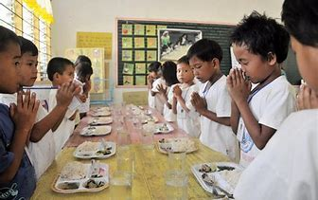


Grace Before Meals by Andrew Chinn
In the name of the Father, and of the Son
And of the Holy Spirit, Amen
Bless this food
And bless the hands that prepared it
And bless the love that we share
We give thanks to you our God
In the name of the Father, and of the Son
And of the Holy Spirit, Amen
© Andrew Chinn 2002

