Slide 1

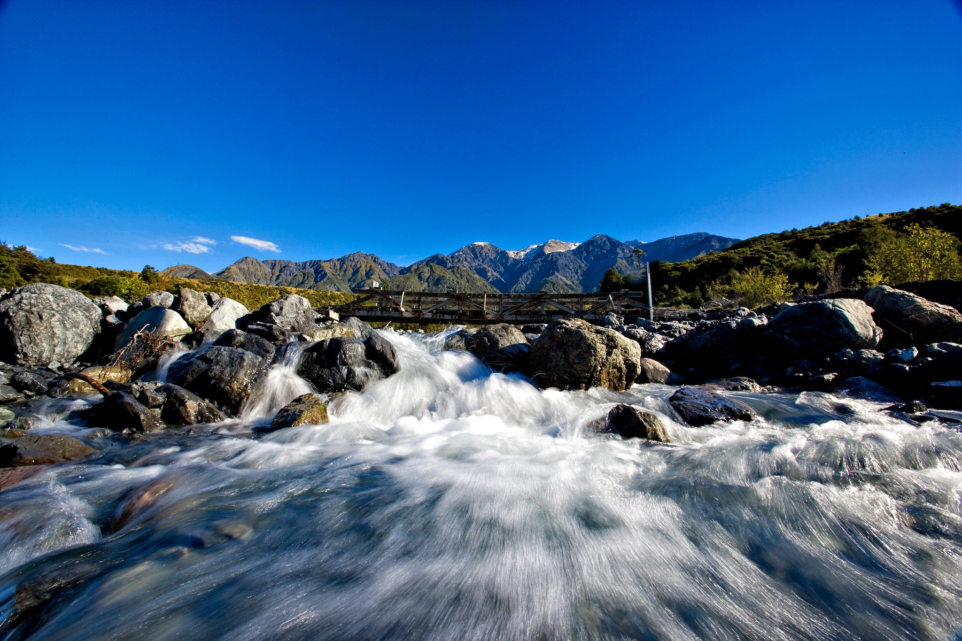


I Am The River by Andrew Chinn
1. I am the river and the river is me
And I flow from the mountain, through the valley to the sea
As I roll and I wander and sing life’s song
The river runs deep and the river runs strong
Water of life, the work of God’s hand
Gift of Creation running through the land
River of life with water so pure
Gift from God giving life anew
© Andrew Chinn 2007

Slide 2
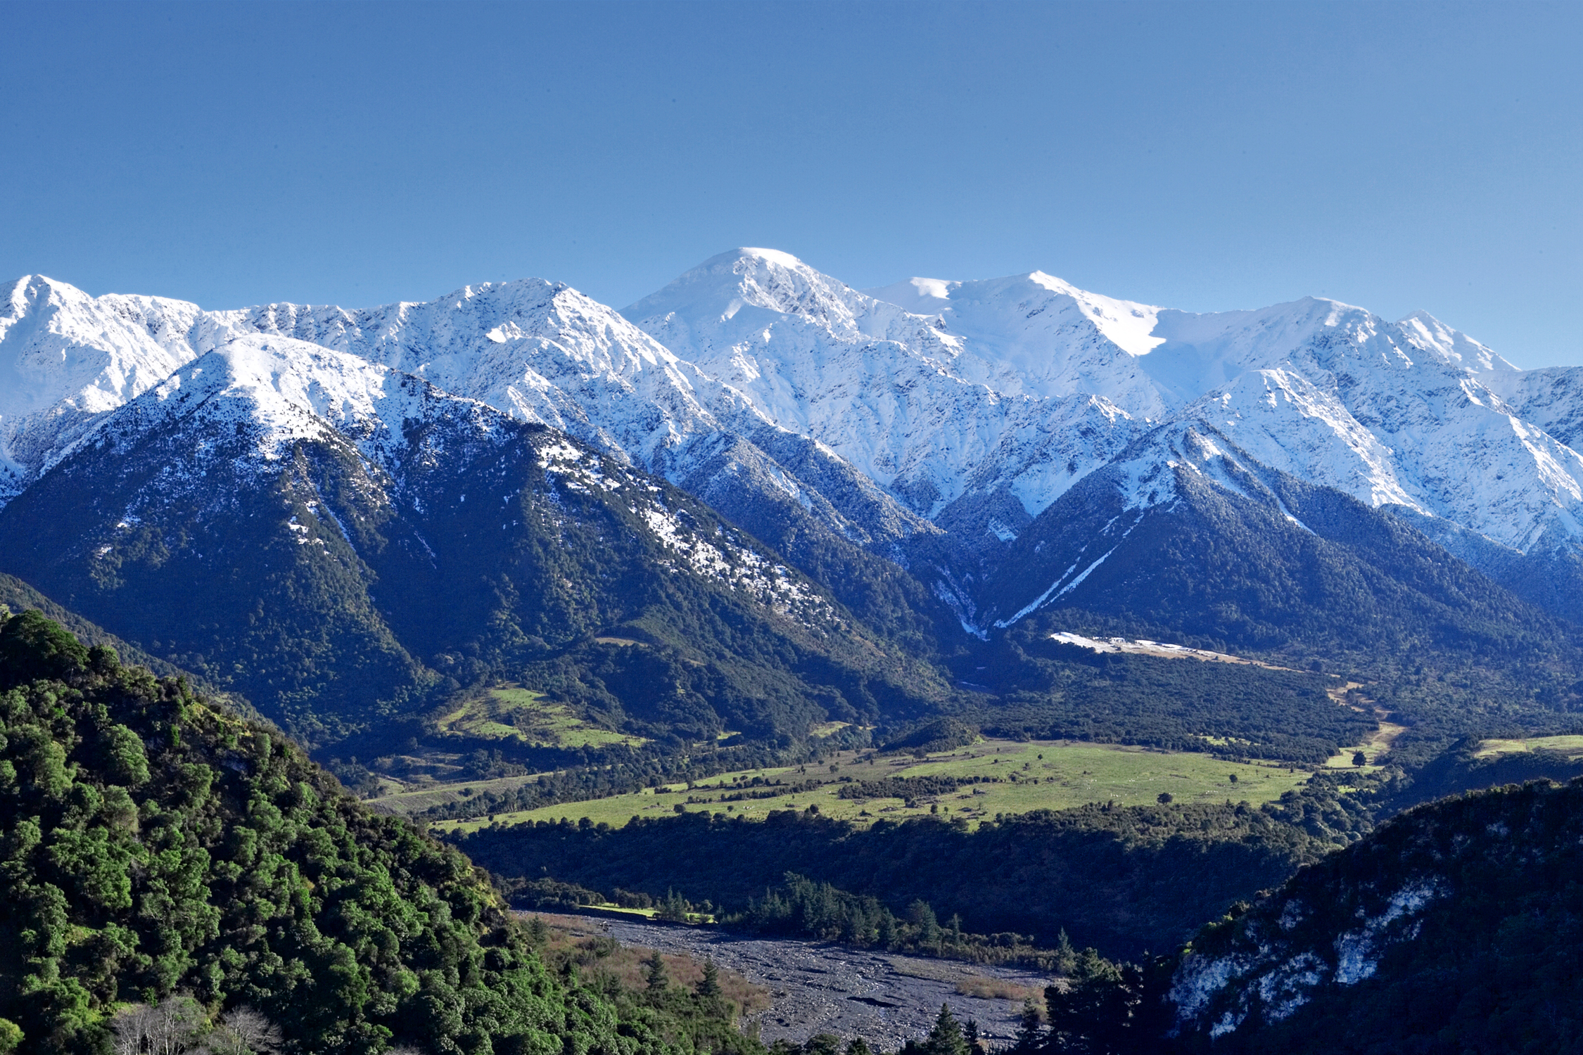
I Am The River (2) by Andrew Chinn
2. I am the mountain and the mountain is me
And I reach from the heavens, part of God’s majesty
I gather all the rain from the skies up above
And send it down to earth, a sign of God’s love
Mountain of life, the work of God’s hand
Gift of creation high above the land
Wellspring of life, sacred place on high
A gift from God reaching up to the sky
© Andrew Chinn 2007

Slide 3
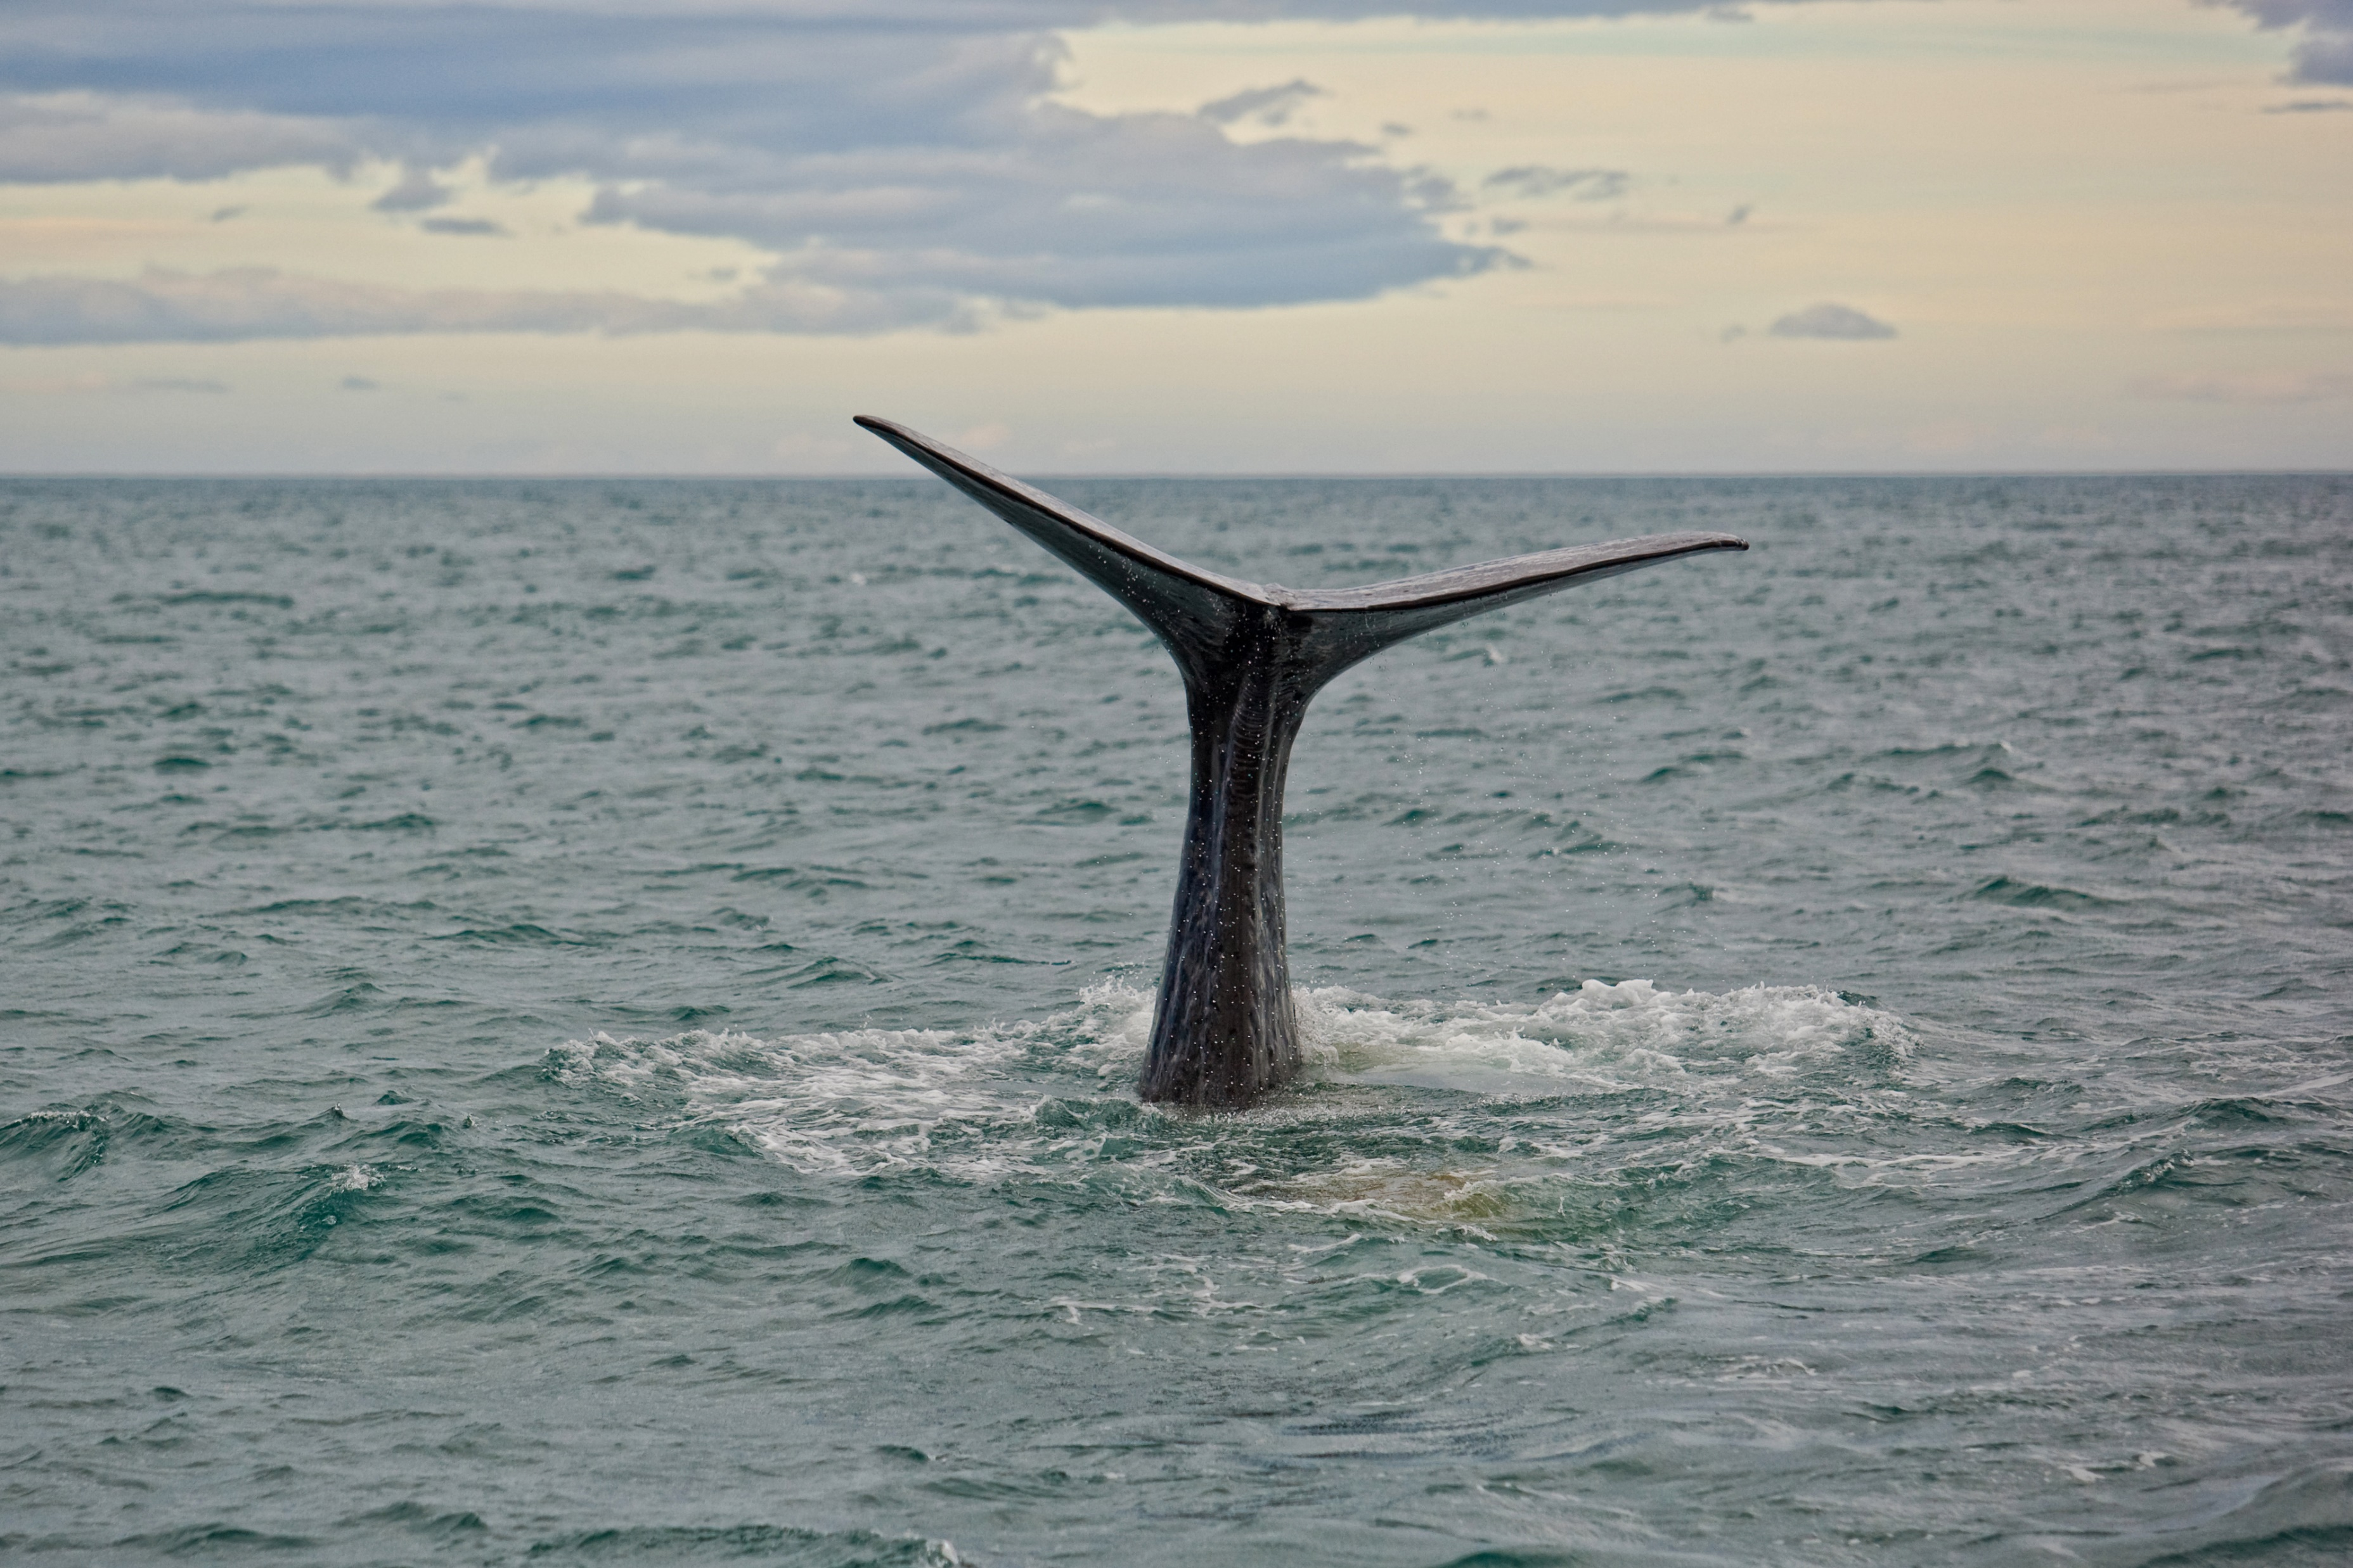
I Am The River (3) by Andrew Chinn
3. I am the ocean and the ocean is me
Giver of life with the winds so free
And I roll and I thunder from the shallow to the deep
All around this world there is life in me
Ocean of life, the work of God’s hand
Gift of creation, the sea and the sands
Giver of life, the ocean so blue
Gift from God for me and you
© Andrew Chinn 2007

Slide 4
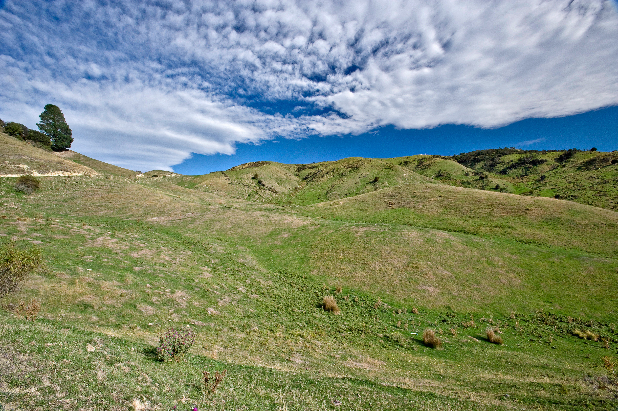
I Am The River (4) by Andrew Chinn
4. I am the land and the land is me
From the top of mountain to the edge of the sea
The plants and the animals find life in me
From the largest of creatures to the mustard seed
Earth of life, the work of God’s hand
Gift of creation, all across the land
Heart of life, deep within the earth
Gift from God the land gives birth
© Andrew Chinn 2007

Slide 5
I Am The River (5) by Andrew Chinn
I am the river and the river is me
And I flow from the mountain,
through the valley to the sea
As I roll and I wander and sing life’s song
The river runs deep and the river runs strong
© Andrew Chinn 2007

