Slide 1

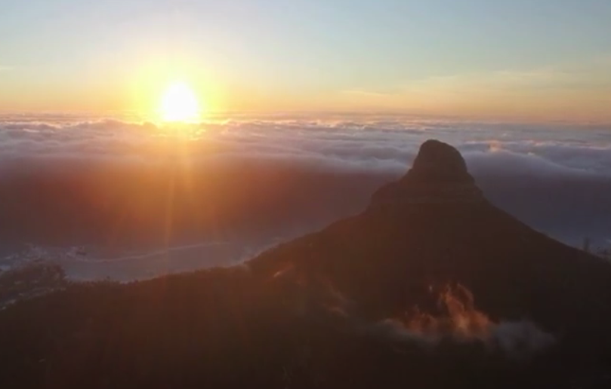

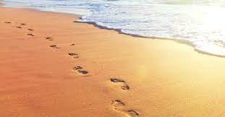
Carry Me Now by Andrew Chinn
On this journey of life, we gently weave
Footprints in the sand, our memories we leave
We join with each other, hearts become one
Surrounded by many, surrounded in love
Oh carry me now, in your arms, oh carry me now
Wherever I am, wherever you are
Oh carry me now, in your heart, oh carry me now
Forever with you, home in your heart
© Andrew Chinn 2012

Slide 2
Carry Me Now (2) by Andrew Chinn
And at times it seemed that I walked alone
No footprints beside me, was I on my own?
In those darkest hours, when I was so low
You lifted me and carried me home
Oh carry me now, in your arms, oh carry me now
Wherever I am, wherever you are
Oh carry me now, in your heart, oh carry me now
Forever with you, home in your heart
© Andrew Chinn 2012

Slide 3
Carry Me Now (3) by Andrew Chinn
In my life I have danced in the light
Journeyed through days and into the night
Through darkest hours, I have been drawn
And now you lead me to a new dawn
Oh carry me now, in your arms, oh carry me now
Wherever I am, wherever you are
Oh carry me now, in your heart, oh carry me now
Forever with you, home in your heart
© Andrew Chinn 2012

