Slide 1

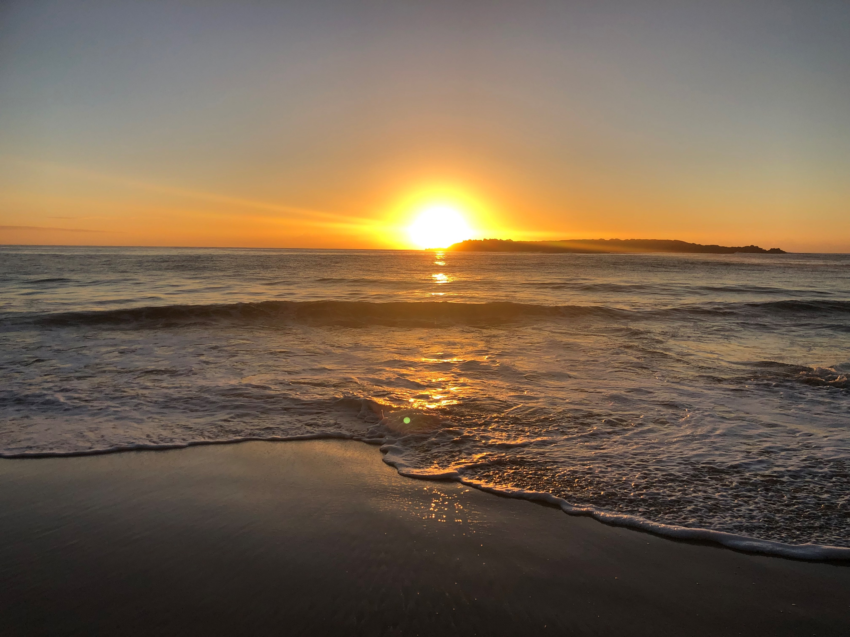


God Of The Morning by Andrew Chinn
God of the Morning, God of my song
God be with me, all my life long
In each breath that I take
and each song that I sing
God be with me, God of Morning
1. Darkness embraces the earth
And silence shrouds our sleep
Silently creeping, your light finds its way
And touches our earth with your peace
© Andrew Chinn 2000

Slide 2
God Of The Morning (2) by Andrew Chinn
God of the Morning, God of my song
God be with me, all my life long
In each breath that I take
and each song that I sing
God be with me, God of Morning
2. One voice reaches out to the light
And a song is gently begun
One voice becomes many, all joined as one
A chorus of joy to Your Sun!
© Andrew Chinn 2000

Slide 3
God Of The Morning (3) by Andrew Chinn
God of the Morning, God of my song
God be with me, all my life long
In each breath that I take
and each song that I sing
God be with me, God of Morning
3. Darkness to royal blue, The stars gently fade
the coolness of early morn heralds the day
The first light of morning turns darkness to blue
The earth it awakens, Your morning anew
© Andrew Chinn 2000

Slide 4
God Of The Morning (4) by Andrew Chinn
God of the Morning, God of my song
God be with me, all my life long
In each breath that I take
and each song that I sing
God be with me, God of Morning
4. Closing my eyes to your touch
Gently I turn to the dawn
First warming rays, touching my face
God with me, God of morn
© Andrew Chinn 2000

