Slide 1

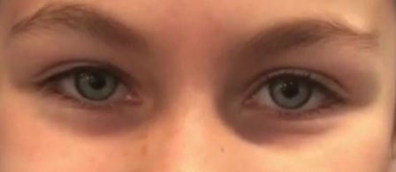


God Gave Me (The Senses Song) by Andrew Chinn
God gave me eyes to see
the wonders of the world
The joy of the sunrise,
the creatures of the earth
To see the moon and stars,
the colours of the rainbow
The smiles of my family
as I learn and grow
© Andrew Chinn 2019

Slide 2
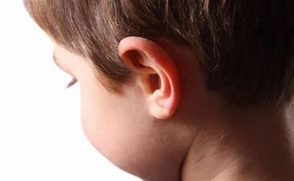
God Gave Me (2) by Andrew Chinn
God gave me ears to hear
the wonders of the world
The sounds of music,
of whispers, shouts and words
To hear the roar of a lion,
the lorikeet’s sweet song
To hear a song of joy,
so I can sing along
© Andrew Chinn 2019

Slide 3
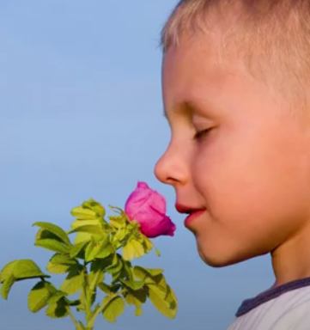
God Gave Me (3) by Andrew Chinn
God gave me a nose to smell
the wonders of the world
The sweet scent of roses,
the fresh spring morning air
The smell of the ocean,
the summer’s salty sea
The scents of the seasons,
the smell of a Christmas tree
© Andrew Chinn 2019

Slide 4
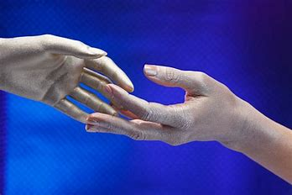
God Gave Me (4) by Andrew Chinn
God gave me skin to feel
the wonders of the world
When I hold a hand
or pat a kitten’s fur
The sun on my face,
the wind blowing through my hair
To share a hug,
to show I really care
© Andrew Chinn 2019

Slide 5
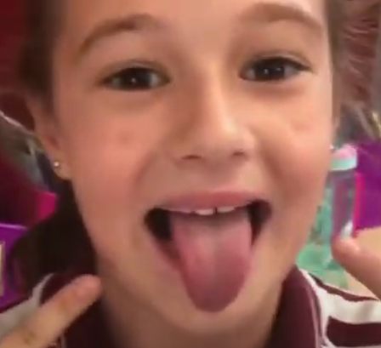
God Gave Me (5) by Andrew Chinn
God gave me a tongue to taste
the wonders of the world
Oranges, apples,
mangoes and juicy pears
A cool drink of water
on a very hot summer’s day
For all our senses,
we give thanks and praise!
© Andrew Chinn 2019

