Slide 1

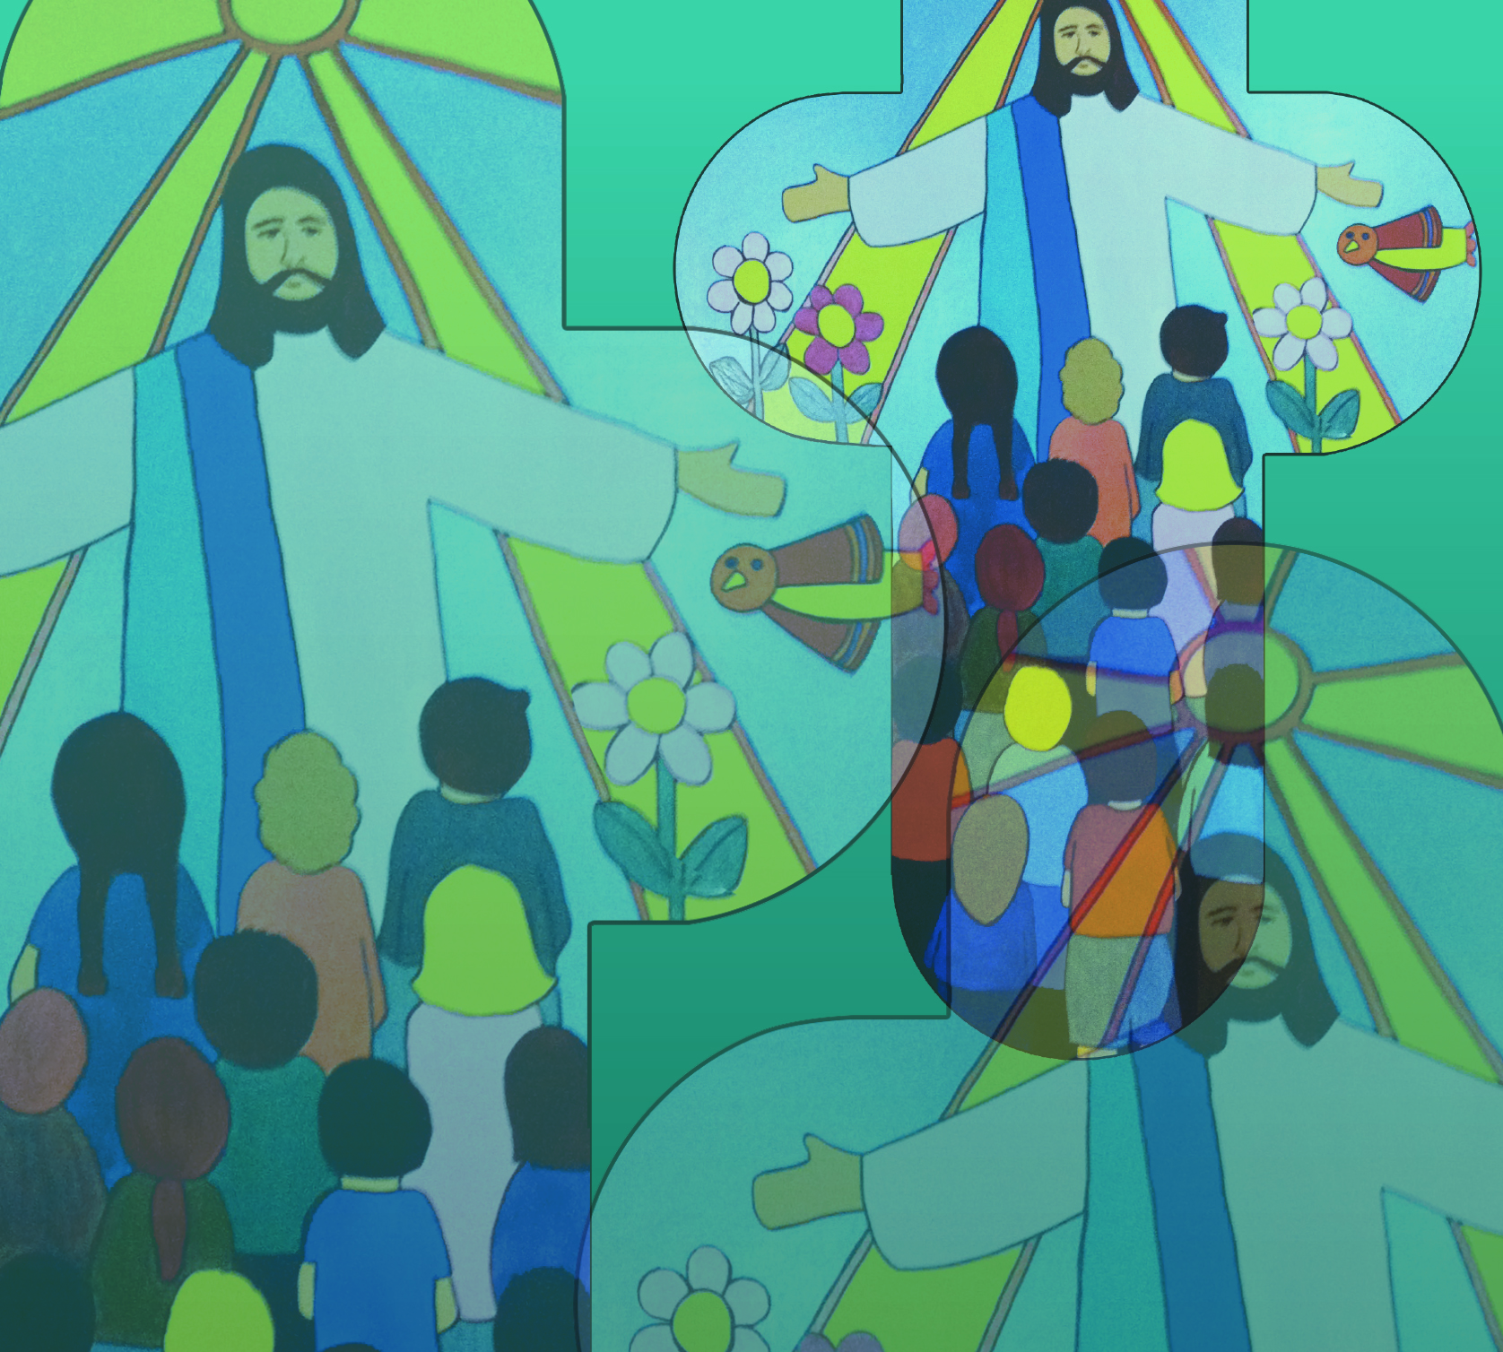

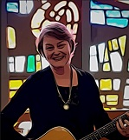
Celebrate – Easter by Jane Mitchell
Welcome to our celebration
come and join the congregation
Lift your voice x x x
Clap your hands x x x
Sing your praise to God
Sing your praise to God
© Jane Mitchell 2011

Slide 2
Celebrate – Easter (2)
Jesus Christ has risen
Happy Easter Day
God has conquered death for all
Hip, hip, hip hooray!
© Jane Mitchell 2011

Slide 3
Celebrate – Easter (3)
Welcome to our celebration
come and join the congregation
Lift your voice x x x
Clap your hands x x x
Sing your praise to God
Sing your praise to God
© Jane Mitchell 2011

