Slide 1

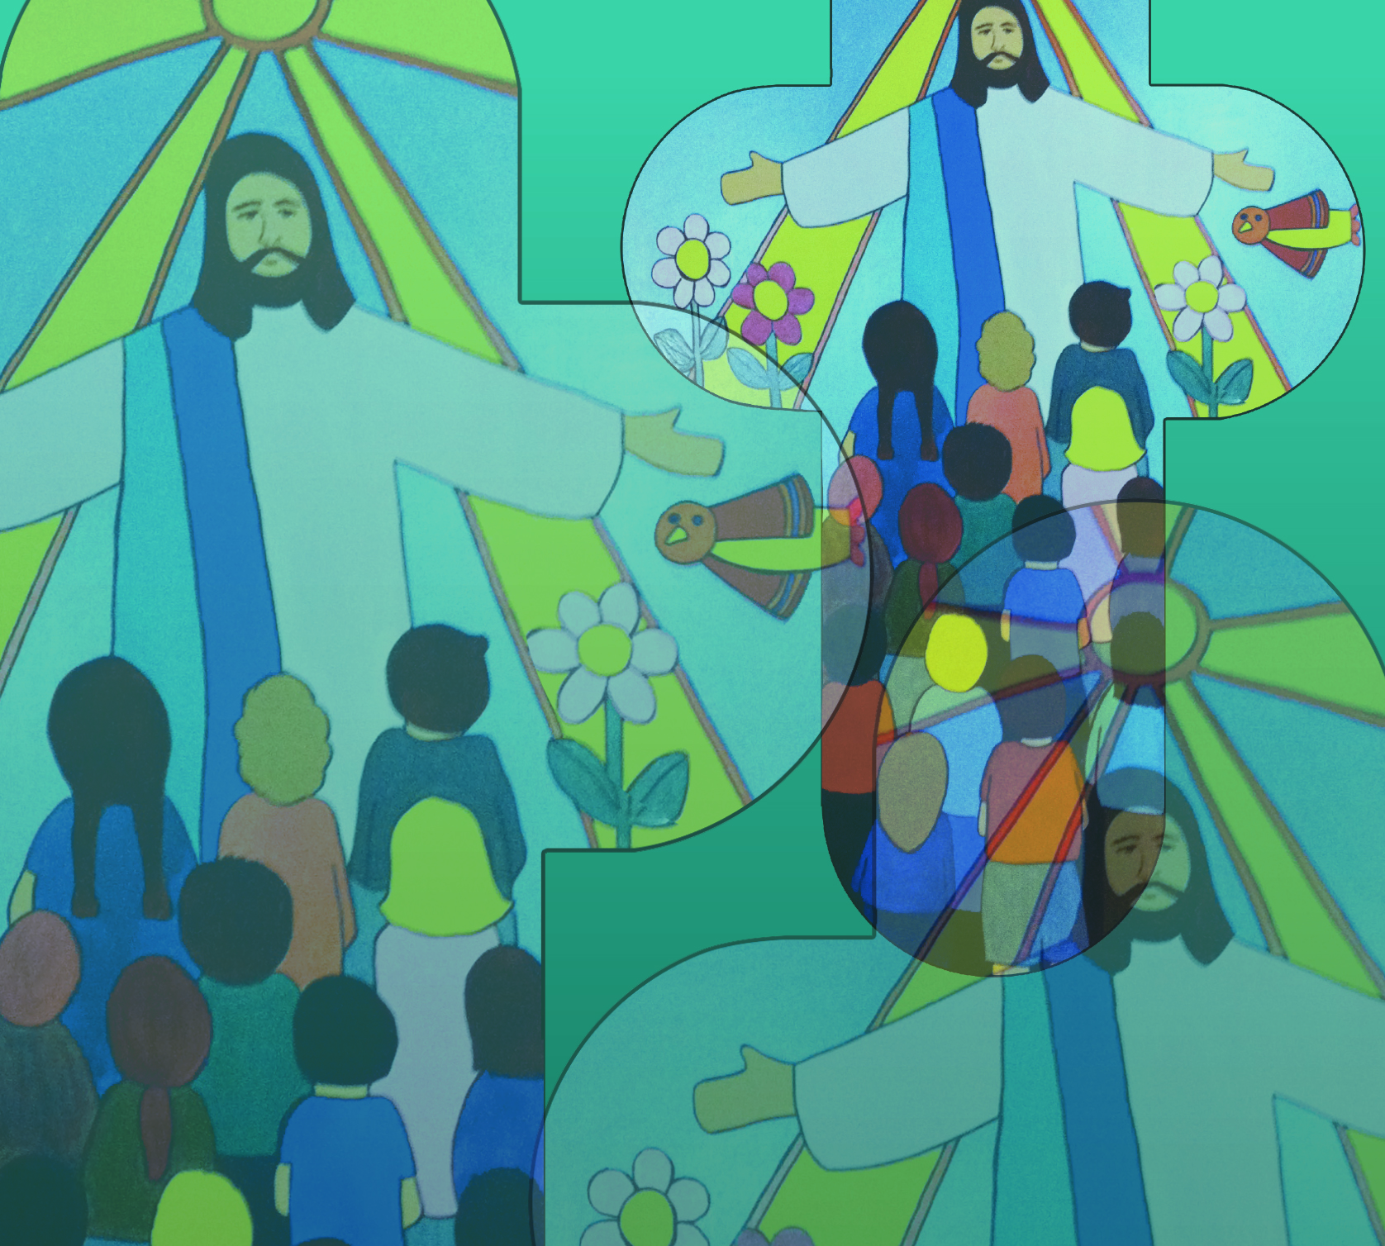

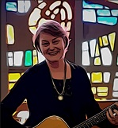
Eucharist Song
by Jane Mitchell
Gathering with those who were your own you prayed,
knowing that your time had come. Taking up the bread then blessed and broken, just like your life, you shared with all and said,
© Jane Mitchell 2011

Slide 2
Eucharist Song (2)
“Take this all of you and eat it,
this is my body
which was give up for you.
Take this all of you and eat it.
You are my friends,
I show my love for you.”
© Jane Mitchell 2011

Slide 3
Eucharist Song (3)
When the supper ended
you took the cup,
the cup that was filled with wine.
You gave thanks and praise
for the Father’s goodness,
you passed the cup
to all your friends and said,
© Jane Mitchell 2011

Slide 4
Eucharist Song (4)
“Take this all of you
and drink from it,
this is my blood,
my covenant with you.
Take this all of you and drink it. Remember me
whenever this you do.”
© Jane Mitchell 2011

Slide 5
Eucharist Song (5)
Gather all who share
in this one cup, one bread,
this sacrifice that gives us life.
Through your Holy Spirit
may we rise as one:
a living sacrifice of joy and praise!
© Jane Mitchell 2011

Slide 6
Eucharist Song (6)
“Take this all of you and eat it,
this is my body
which is given up for you.
Take this all of you and drink it. Remember me
whenever this you do.
Remember me
whenever this you do.”
© Jane Mitchell 2011

