Slide 1

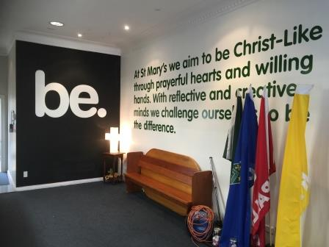


Be God’s Mercy by Andrew Chinn
God of love
with prayerful hearts we turn to you-
May we always live in your truth
God of mercy
we’re willing hands to those in need,
May the good we do each day
bring your peace
© Andrew Chinn/Butterfly Music 2019

