Slide 1

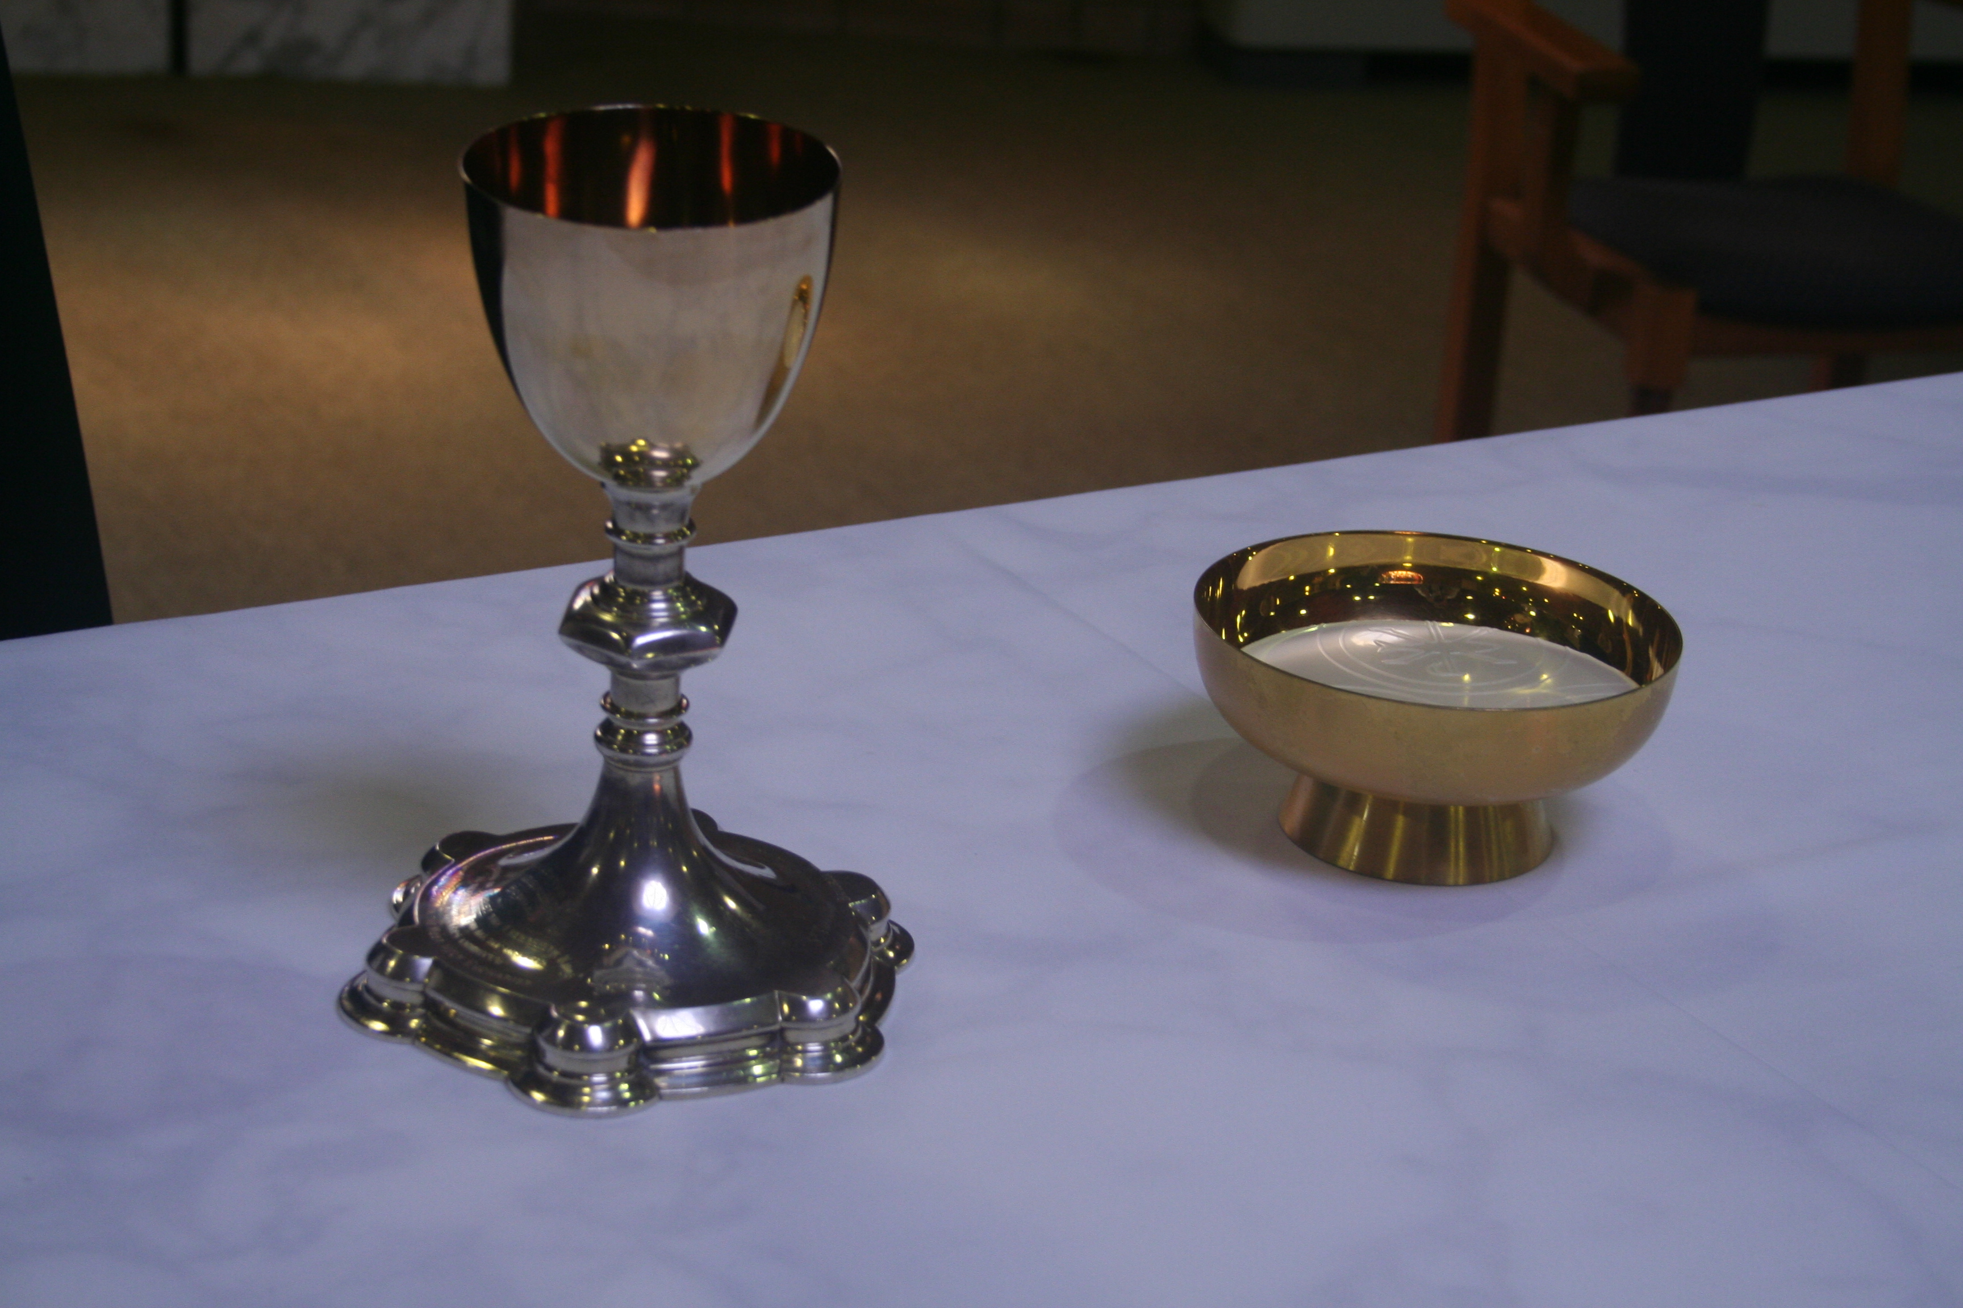


I Am The Bread Of Life
I am the bread of life
Those who come to me shall not hunger
All who believe in me shall not thirst
They shall have everlasting life
All those who come to me
I will not turn away
I will raise them all
To life on the last day
© Andrew Chinn/Butterfly Music 2019

Slide 2
I Am The Bread Of Life (2)
I am the bread of life
Those who come to me shall not hunger
All who believe in me shall not thirst
They shall have everlasting life
No-one can come to me
Unless they are called
I am the living bread
Given for life, for all
© Andrew Chinn/Butterfly Music 2019

Slide 3
I Am The Bread Of Life (3)
I am the bread of life
Those who come to me shall not hunger
All who believe in me shall not thirst
They shall have everlasting life
All who eat and drink of me
For my flesh is real food
You will live in me
And I will live in you
© Andrew Chinn/Butterfly Music 2019

