Slide 1
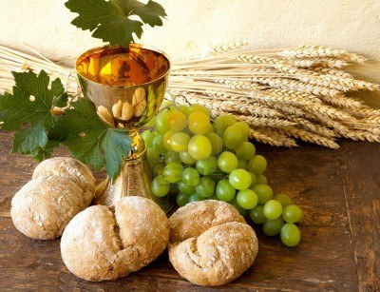
Offertory Hymn
Come to the Table – Andrew Chinn
Come to the table, come to the feast!
Come to the table of the Lord!
Bringing gifts of bread and wine,
come with open hearts
Come to the table of the Lord
This bread that we bring, and offer now to You
It will become your Body,
it will our hearts renew
We offer this gift of bread
with true and humble hearts
With all that we bring, all that we are!

Slide 2
Come to the table, come to the feast!
Come to the table of the Lord!
Bringing gifts of bread and wine,
come with open hearts
Come to the table of the Lord
This wine that we bring,
and offer now to You
It will become your Blood,
it will our hearts renew
We offer this gift of wine
with true and humble hearts
With all that we bring, all that we are!

Slide 3
Come to the table, come to the feast!
Come to the table of the Lord!
Bringing gifts of bread and wine,
come with open hearts
Come to the table of the Lord
Our lives that we bring,
and offer now to You
May you live within our hearts,
may we rest in You
We offer this gift of our lives
with all our hearts
With all that we bring, all that we are!
© Andrew Chinn, 2014

