Slide 1

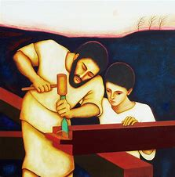

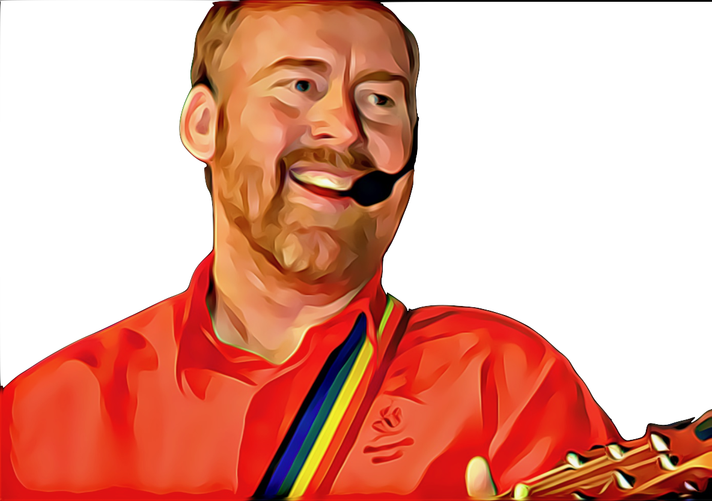
A School Prayer
Lord, be with us through the day
Help us understand the way
To follow right and never wrong
And make our love grow ever strong
St Joseph protect us at work and play
And guide our teachers every day
To lead us along the right paths
This, dear Lord, is what we ask
Words by Amanda Svanetti © Andrew Chinn/Butterfly Music 2000

