Slide 1

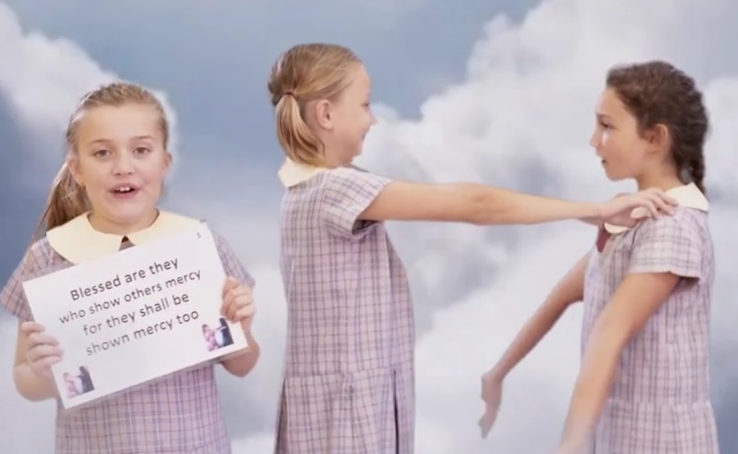


Beatitudes by Andrew Chinn
Blessed are they the poor in spirit,
for theirs is the kingdom of God
Blessed are they, who mourn for others
for they will be comforted.
Blessed are they, those who are gentle
For they shall inherit the earth
Blessed are they who seek what is right
For they shall be satisfied
© Andrew Chinn/Butterfly Music 2014

Slide 2
Beatitudes (2) by Andrew Chinn
Blessed are they who show others mercy
for they shall be shown mercy too
Blessed are they, the pure in heart
for they will see the face of God
Blessed are they, who work to bring peace
For they will be the children of God
Blessed are they who suffer for God’s sake
The kingdom of heaven belongs to them
© Andrew Chinn/Butterfly Music 2014

Slide 3
Beatitudes (3) by Andrew Chinn
Blessed are you when others insult you
And speak against you because of me
Rejoice and be glad, your reward is in heaven
for in the same way, the prophets ‘fore you
© Andrew Chinn/Butterfly Music 2014

