Slide 1

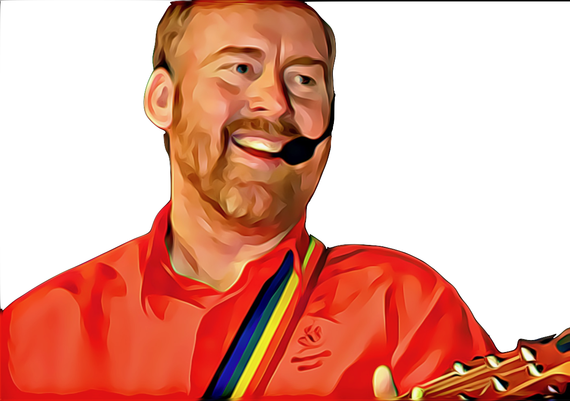
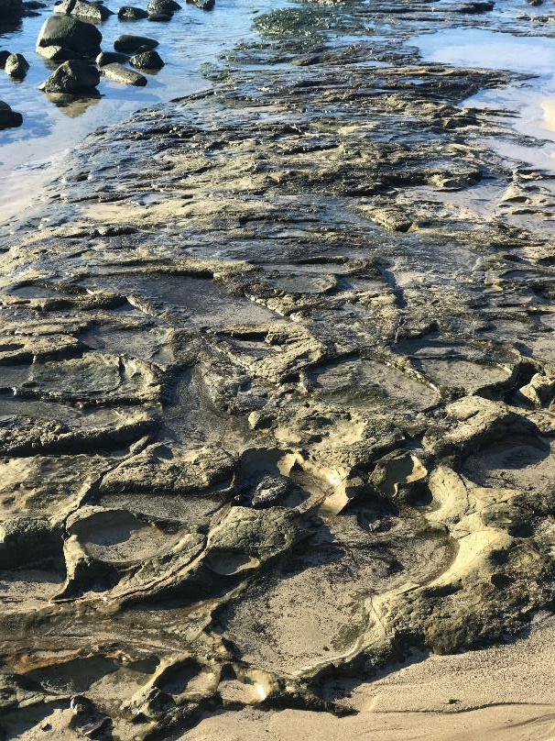

Ancient Legacy by Andrew Chinn
1. We acknowledge elders… We acknowledge elders
Elders of the past… Elders of the past
Elders present with us… Elders present with us
With the land as one… With the land as one
Oooh, oooh… With the land as one
2. Custodians of land… Custodians of land,
custodians of sea… custodians of sea
Ancient people… ancient people,
ancient legacy… ancient legacy
Oooh, oooh … ancient legacy
© Andrew Chinn/Butterfly Music 2019

Slide 2
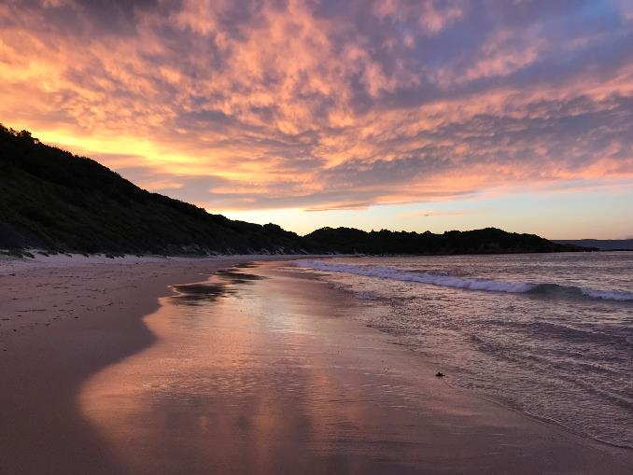
Ancient Legacy (2) by Andrew Chinn
3. Ancient people… ancient people
In an ancient land…in an ancient land
We pay our respects… we pay our respects
Living story of our land… living story of our land
Oooh, oooh… living story of our land
4. People of strength… people of strength
People of courage… people of courage
Ancient people of this place… ancient people of this place
First people of this land… first people of this land
Oooh, oooh… first people of this land
© Andrew Chinn/Butterfly Music 2019

