Slide 1

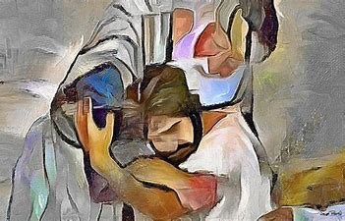

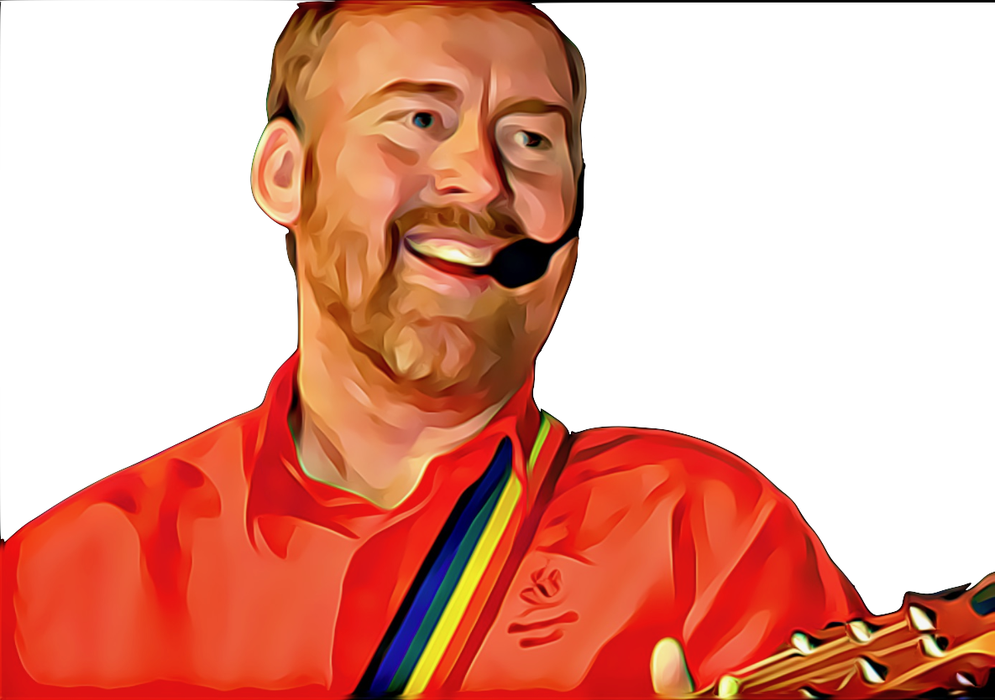
Come Back To Me
Come back to me, my love is strong
Come back to me, my love is strong
Come back to me, my love is strong
Come back to me, my love is strong
© Andrew Chinn/Butterfly Music 2007

Slide 2
Come Back To Me (2)
When you are weary, come back to me
When you are weary, come back to me
When you are weary, come back to me
When you are weary, come back to me
© Andrew Chinn/Butterfly Music 2007

Slide 3
Come Back To Me (3)
When you have lost the way, I will find you
When you have lost the way, I will find you
When you have lost the way, I will find you
When you have lost the way, I will find you
© Andrew Chinn/Butterfly Music 2007

Slide 4
Come Back To Me (4)
Look within your heart, you will find me
Look within your heart, you will find me
Look within your heart, you will find me
Look within your heart, you will find me
© Andrew Chinn/Butterfly Music 2007

