Slide 1

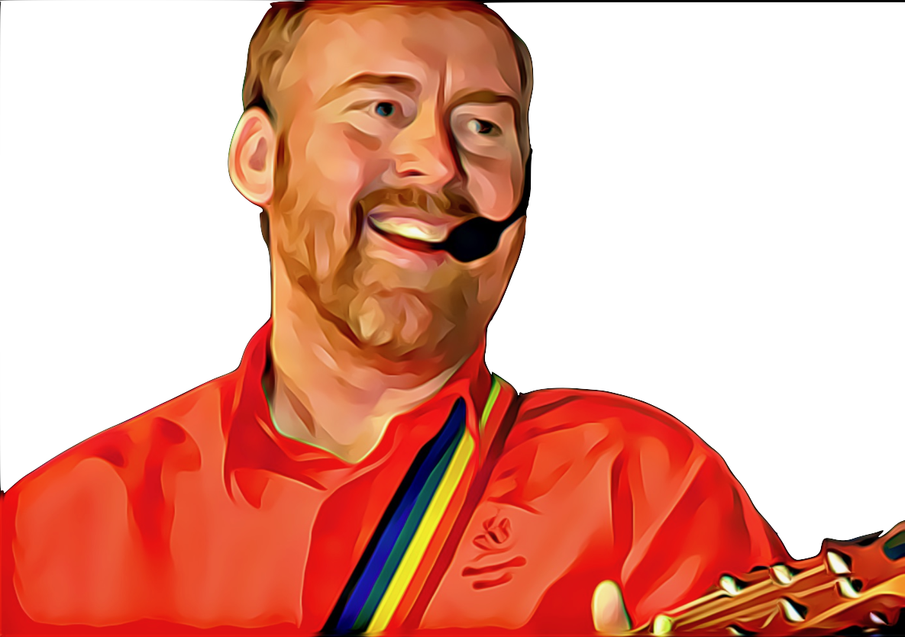
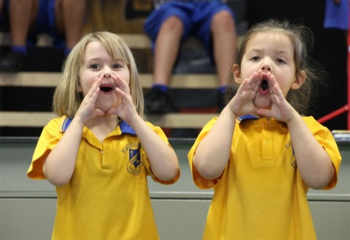

Gotta Sing, Gotta Pray by Andrew Chinn
Gotta sing (la la), gotta pray (uh-huh)
Gotta love my God each day
Gotta sing gotta pray, gotta love my God each day
Gotta love (gotta love) one another (one another)
Gotta love, sisters and brothers
Gotta sing gotta pray, gotta love one another each day
Love your God with all your heart
With all your soul and all your mind
Jesus said this to us all
Gotta love our God all the time
© Andrew Chinn/Butterfly Music 2014

Slide 2
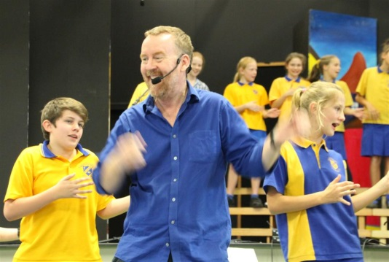
Gotta Sing, Gotta Pray (2) by Andrew Chinn
Gotta sing (la la), gotta pray (uh-huh)
Gotta love my God each day
Gotta sing gotta pray, gotta love my God each day
Gotta love (gotta love) one another (one another)
Gotta love, sisters and brothers
Gotta sing gotta pray, gotta love one another each day
Love each other with all your heart
Reach out in love, be good and kind
Jesus said this to us all
Gotta love one another all the time
© Andrew Chinn/Butterfly Music 2014

