Slide 1



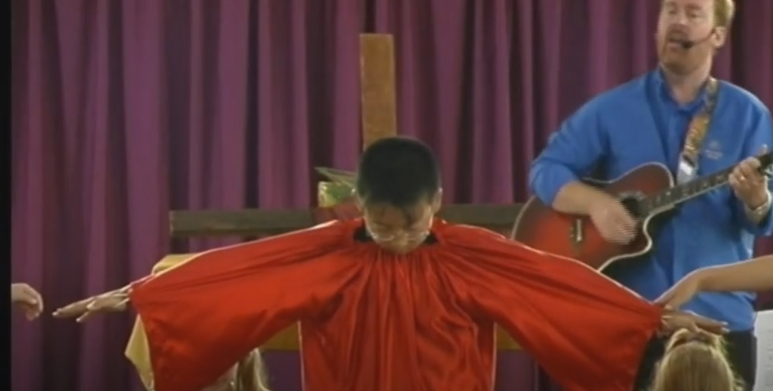
Dying You Destroyed Our Death by Andrew Chinn
1. Stay here and watch and pray with me
My sorrow is great but God's will must be done
The time has come, the hour is now
Sealed with a kiss, and left all alone
Dying, you destroyed our death
Rising, you restore our life
Lord Jesus, come in glory
© Andrew Chinn/Butterfly Music, 2000

Slide 2
Dying You Destroyed Our Death (2) by Andrew Chinn
2. Gathered against me and calling for my death
"Are you the Son of God?" I said, "So you say"
Guilty of nothing, yet sentenced to die
I came to bring truth, to speak your word today
Dying, you destroyed our death
Rising, you restore our life
Lord Jesus, come in glory
© Andrew Chinn/Butterfly Music 2000

Slide 3
Dying You Destroyed Our Death (3) by Andrew Chinn
3. Stripped of my clothes, my life mocked away
So many standing near, but all so far apart
Cry not for me but cry for yourselves
My cross is so heavy, yet more is my heart
Dying, you destroyed our death
Rising, you restore our life
Lord Jesus, come in glory
© Andrew Chinn/Butterfly Music 2000

Slide 4
Dying You Destroyed Our Death (4) by Andrew Chinn
4. Day turned to night, the light turned to black
"Why," I cried, "have you left me all alone?"
My own light fading, I turned back to you
Into your hands my God, my Spirit came home
Dying, you destroyed our death
Rising, you restore our life
Lord Jesus, come in glory
© Andrew Chinn/Butterfly Music 2000

