Slide 1

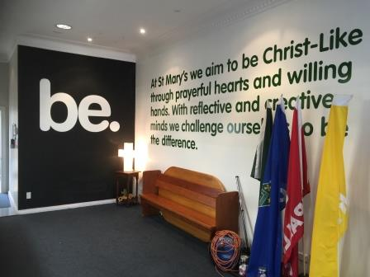


Be God’s Love by Andrew Chinn
Be truth … tika tika, live in God’s word
Be wisdom …maramatanga, light for the world
Be faith whakapono, in God above
Be love, be love … aroha, be God’s love
With prayerful hearts we listen to your word
We hear your truth and take it to the world
We are true to our self, to others and to you
May we live like you in all we say and do
© Andrew Chinn/Butterfly Music 2019

Slide 2
Be God’s Love (2) by Andrew Chinn
Be truth … tika tika, live in God’s word
Be wisdom …maramatanga, light for the world
Be faith whakapono, in God above
Be love, be love … aroha, be God’s love
With willing hands joined together we pray
We reach out to others, do a little good each day
Helping hands, helping hearts together we are called
Open eyes, open hearts Be the difference in our world
© Andrew Chinn/Butterfly Music 2019

Slide 3
Be God’s Love (3) by Andrew Chinn
Be truth … tika tika, live in God’s word
Be wisdom …maramatanga, light for the world
Be faith whakapono, in God above
Be love, be love … aroha, be God’s love
Mary Mother of God, pray for us
Mary Mother of all, pray for us
Mary, Queen of Peace, pray for us
Mary who heard God’s call, pray for us
© Andrew Chinn/Butterfly Music 2019

