Slide 1
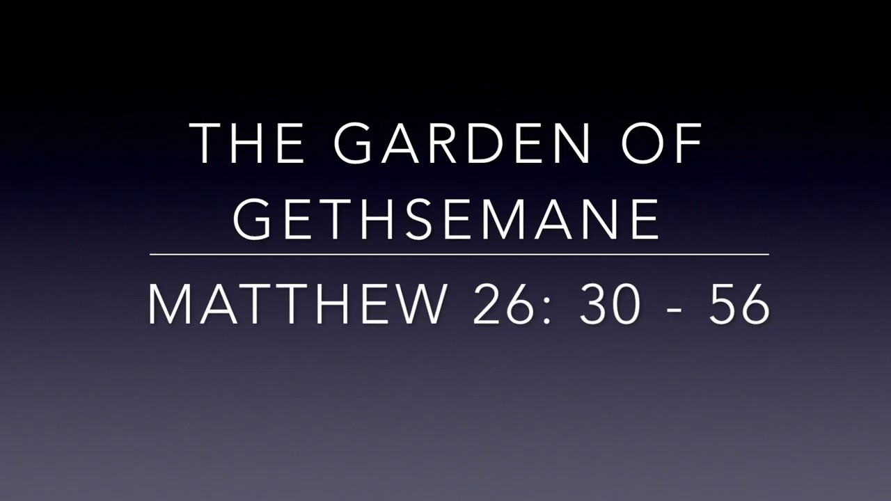
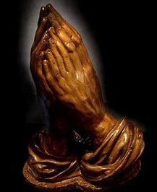


Garden of Gethsemane by Andrew Chinn
Walk with me, stay with me
In the darkness, pray with me
Walk with me, stay with me
In the darkness, pray with me
© Andrew Chinn/Butterfly Music 2007

Slide 2
Garden of Gethsemane (2) by Andrew Chinn
Stay with me, watch with me
In my darkness, pray with me
Stay with me, watch with me
In my darkness, pray with me
© Andrew Chinn/Butterfly Music 2007

Slide 3
Garden of Gethsemane (2) by Andrew Chinn
My sorrow is heavy, it crushes me
Father take this cup from me
My sorrow is heavy, it crushes me
Father take this cup from me
© Andrew Chinn/Butterfly Music 2007

Slide 4
Garden of Gethsemane (2) by Andrew Chinn
Not my will, but your will be done
My time is now, the hour has come
Not my will, but your will be done
My time is now, the hour has come
© Andrew Chinn/Butterfly Music 2007

