Slide 1


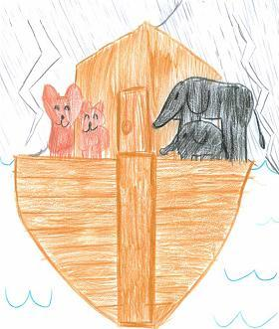

Arky Arky
Traditional
1. The Lord told Noah there’s gonna be a floody, floody
The Lord told Noah there’s gonna be a floody, floody
Get those animals out of the muddy-muddy
Children of the Lord
So rise and shine and give God the glory glory!
Rise and shine and give God the glory glory!
Rise and shine and give God the glory glory!
Children of the Lord
2. The Lord told Noah to build Him an Arky Arky
The Lord told Noah to build Him an Arky Arky
Build it out of gopher barky-barky
Children of the Lord
Traditional

Slide 2
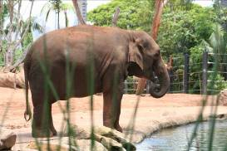
Arky Arky (2) by Andrew Chinn
3. The animals, the animals, they came in by twosies-twosies
The animals, the animals, they came in by twosies-twosies
Elephants and Kangaroosies-roosies
Children of the Lord
So rise and shine and give God the glory glory!
Rise and shine and give God the glory glory!
Rise and shine and give God the glory glory!
Children of the Lord
4. It rained and poured for forty daysies-daysies
It rained and poured for forty daysies-daysies
Almost drove those animals crazies-crazies
Children of the Lord
Traditional

Slide 3
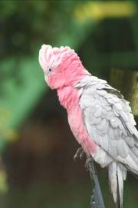
Arky Arky (3) by Andrew Chinn
5. The sun came out and dried up the landy-landy
Look! It’s the sun! It’s dried up the landy-landy!
Everything was fine and dandy-dandy
Children of the Lord
So rise and shine and give God the glory glory!
Rise and shine and give God the glory glory!
Rise and shine and give God the glory glory!
Children of the Lord
Traditional

