Slide 1

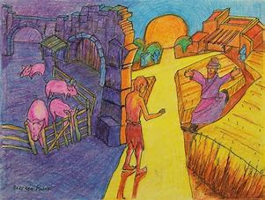

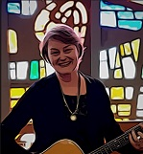
The Forgiving Father by Jane Mitchell
I trust you my son
to stay here by my side
I trust you to be true to me.
I’ll give you new shoes,
New shoes to help you walk
And I’ll trust you to walk
To walk with me
© Jane Mitchell 2015

Slide 2
The Forgiving Father (2) by Jane Mitchell
1. You wandered far away
You tried a different path
I worried and I watched
For your return
And now you have come back
It’s time to celebrate
My love for you continued burning strong
And I’ll…
© Jane Mitchell 2015

Slide 3
The Forgiving Father (3) by Jane Mitchell
I trust you my son
to stay here by my side
I trust you to be true to me.
I’ll give you new shoes,
New shoes to help you walk
And I’ll trust you to walk
To walk with me
© Jane Mitchell 2015

Slide 4
The Forgiving Father (4)
by Jane Mitchell
2. My father, my father
You give me back my life
From the depths of pain and guilt
I am returned
For now I have come home
My dignity’s restored
Through love that continued burning strong
And I’ll …
© Jane Mitchell 2015

Slide 5
The Forgiving Father (5) by Jane Mitchell
I trust you my son
to stay here by my side
I trust you to be true to me.
I’ll give you new shoes,
New shoes to help you walk
And I’ll trust you to walk
To walk with me
© Jane Mitchell 2015

