Slide 1

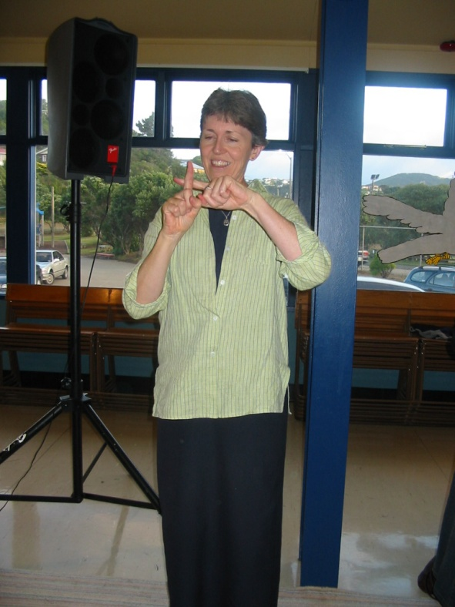


Christ In My Vessel by Andrew Chinn
With Christ in my vessel I can smile at the storm
Smile at the storm, smile at the storm
With Christ in my vessel
I can smile at the storm, as we go sailing home
Sailing, sailing home
Sailing, sailing home
With Christ in my vessel
I can smile at the storm
As we go sailing home
Traditional/Public Domain

Slide 2

Christ In My Vessel (2) by Andrew Chinn
With ______ in my vessel I can smile at the storm
Smile at the storm, smile at the storm
With _______ in my vessel
I can smile at the storm, as we go sailing home
Sailing, sailing home
Sailing, sailing home
With ________ in my vessel
I can smile at the storm
As we go sailing home
Traditional/Public Domain

Slide 3
Christ In My Vessel (3) by Andrew Chinn
With ______ in my ______ I can smile at the storm
Smile at the storm, smile at the storm
With _______ in my ______
I can smile at the storm, as we go sailing home
Sailing, sailing home
Sailing, sailing home
With ________ in my ______
I can smile at the storm
As we go sailing home
Traditional/Public Domain

Slide 4
Christ In My Vessel (4) by Andrew Chinn
With ______ in my _____ I can _____ at the storm
_____ at the storm, _____ at the storm
With _______ in my _____
I can _____ at the storm, as we go sailing home
Sailing, sailing home
Sailing, sailing home
With ________ in my _____
I can _____ at the storm
As we go sailing home
Traditional/Public Domain

Slide 5
Christ In My Vessel (5) by Andrew Chinn
With ______ in my _____ I can _____ at the _____
_____ at the _____, _____ at the _____
With _______ in my vessel
I can _____ at the _____, as we go sailing home
Sailing, sailing home
Sailing, sailing home
With ________ in my _____
I can _____ at the _____
As we go sailing home
Traditional/Public Domain

