Slide 1

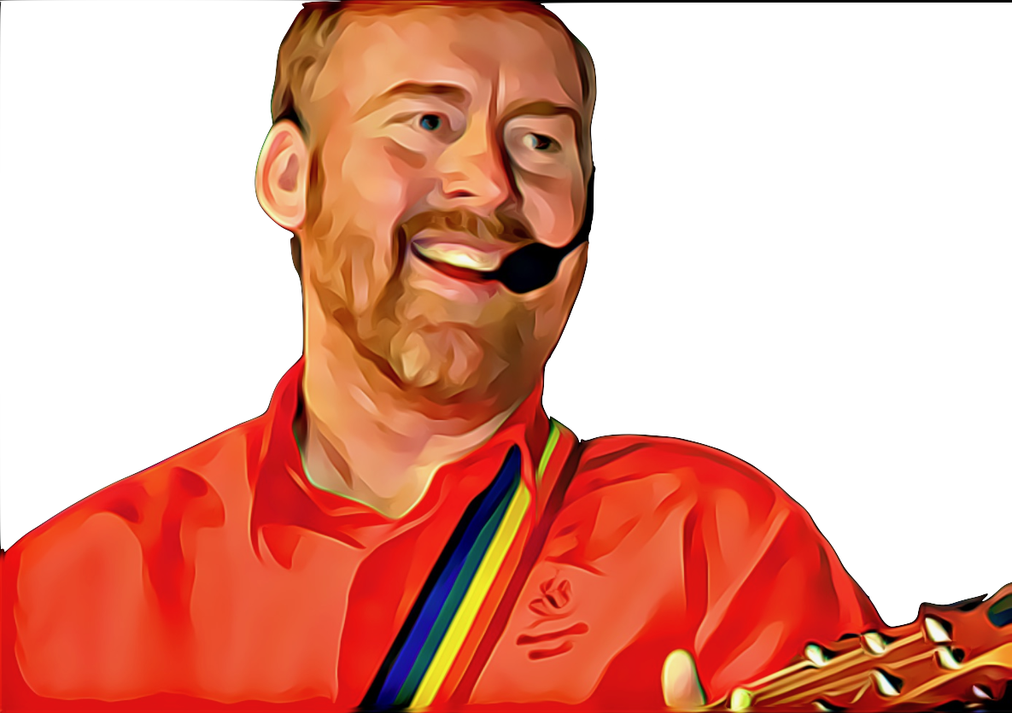

Christ Be With Me by Andrew Chinn
1. Christ be with me Christ be with me
Christ be within me Christ be within me
Christ be before me Christ be before me
Christ be behind me Christ be behind me
2. Christ beneath me Christ beneath me
Christ above me Christ above me
Christ at my right hand Christ at my right hand
Christ at my left hand Christ at my left hand
© Andrew Chinn/Butterfly Music 2022

Slide 2
Christ Be With Me (2) by Andrew Chinn
Christ in the hearts of all who think of me,
Christ in the mouths of all who speak of me,
Christ in all eyes that see me
Christ in all ears that hear me
Christ all around me Christ all around me
Christ in my lying down Christ in my lying down
Christ in my sitting Christ in my sitting
Christ in my rising Christ in my rising
© Andrew Chinn/Butterfly Music 2022

