Slide 1




I Have Called You By Name by Andrew Chinn
I have called you by name and you are mine
I am with you always 'til the end of time
You are precious and honoured and special too
You live in me... and I love you
1. My name is Andrew and it means strong
Mine is Belinda, it means beautiful
Mine is Nicole, it means victory
My name is special... and God loves me!
© Andrew Chinn 2000

Slide 2

I Have Called You By Name (2) by Andrew Chinn
I have called you by name and you are mine
I am with you always 'til the end of time
You are precious and honoured and special too
You live in me... and I love you
2. My name is Peter and it means rock
Mine is Samantha, it means listener
Mine is John, it means God gave me
My name is special... and God loves me!
© Andrew Chinn 2000

Slide 3
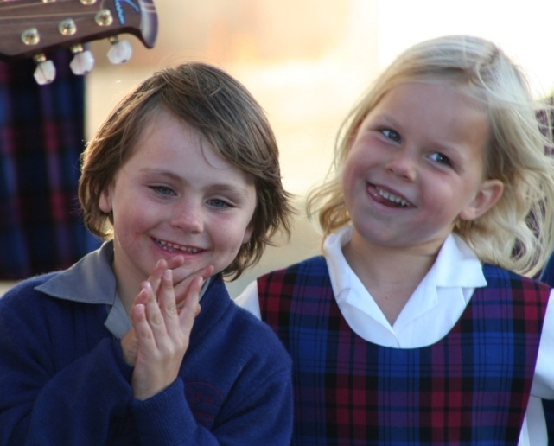
I Have Called You By Name (3) by Andrew Chinn
I have called you by name and you are mine
I am with you always 'til the end of time
You are precious and honoured and special too
You live in me... and I love you
3. My name is Lauren and it means a crown
Mine is Matthew, it means Gift of God
Mine is Melissa, and it means bee
My name is special... and God loves me!
© Andrew Chinn 2000

Slide 4

I Have Called You By Name (4) by Andrew Chinn
I have called you by name and you are mine
I am with you always 'til the end of time
You are precious and honoured and special too
You live in me... and I love you
4. My name is Michael, it means "like God"
Mine is Adam and it means Red Earth
Mine is Rhiannon, it means fairy
My name is special... and God loves me!
© Andrew Chinn 2000

