Slide 1

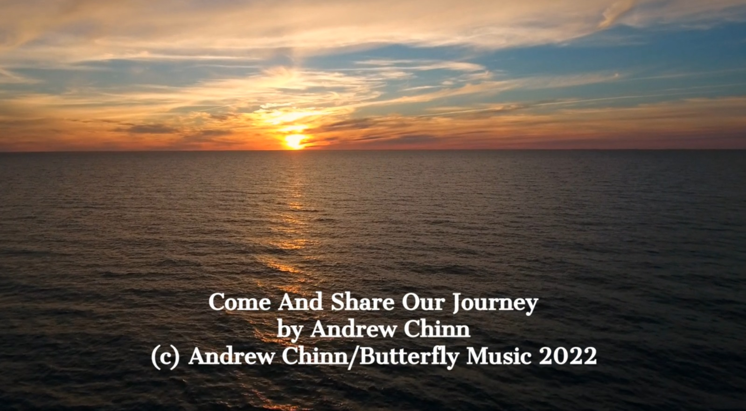


Come and Share Our Journey by Andrew Chinn
Come and share our journey, come and sing our song
Together in the Spirit, united in God
With arms that are open, a welcome for all
We celebrate our spirit, in this family of love
1. Called by our faith, to this sacred place
Open minds, open hearts, many lands, many faces
Together on this journey to find new ways
In the footsteps of Jesus, we journey in faith
© Andrew Chinn/Butterfly Music 2022

Slide 2
Come And Share Our Journey (2)
Come and share our journey, come and sing our song
Together in the Spirit, united in God
With arms that are open, a welcome for all
We celebrate our spirit, in this family of love
2. In our currach of friendship we sail into these seas
Working together, to learn and grow in peace
We share our gifts, we lend a helping hand
We journey to the future, together we can
© Andrew Chinn/Butterfly Music 2022

Slide 3
Come And Share Our Journey (3)
Come and share our journey, come and sing our song
Together in the Spirit, united in God
With arms that are open, a welcome for all
We celebrate our spirit, in this family of love
3. From our journey here to new places we will go
With courage in our hearts, we go forward in hope
Never giving up, with Christ to light the way
Together in our hearts, together all our days
© Andrew Chinn/Butterfly Music 2022

