Slide 1

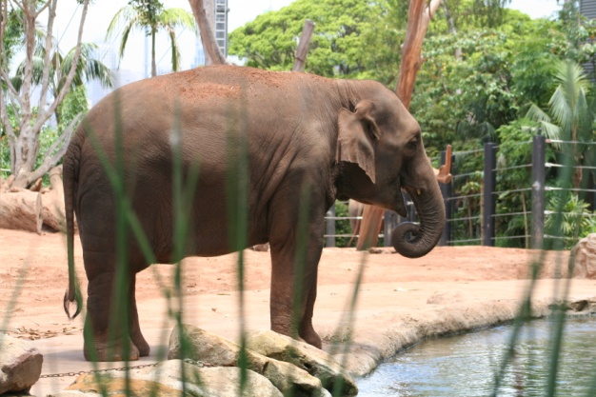


God Made Them All by Andrew Chinn
Oh, way oh! God made them all!
Oh, way oh! God made them all!
God made the creatures of the land
The monkeys and the apes, the orangutans
The elephant and the kangaroo
The lions and the tigers too!
© Andrew Chinn 2017

Slide 2
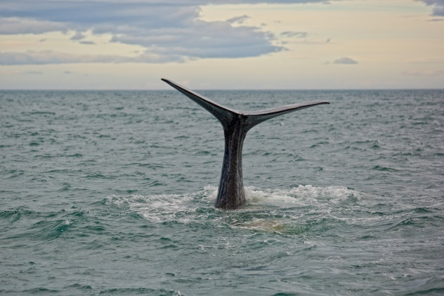
God Made Them All (2) by Andrew Chinn
Oh, way oh! God made them all!
Oh, way oh! God made them all!
God made the creatures of the sea
The bream and the cod and the barramundi
The whales and the dolphins, the octopus
And over by the river a platypus
© Andrew Chinn 2017

Slide 3
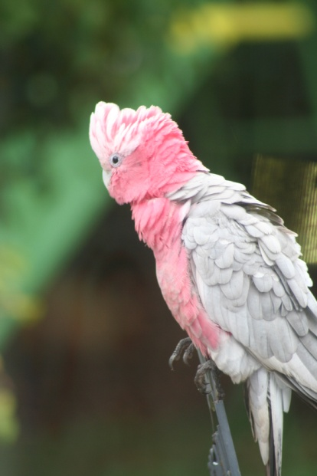
God Made Them All (3) by Andrew Chinn
Oh, way oh! God made them all!
Oh, way oh! God made them all!
God made the creatures of the sky
The birds of the heavens that fly so high
Kookaburra, eagles and cockatoos
The ones that don’t fly, kiwis and emus!
© Andrew Chinn 2017

