Slide 1

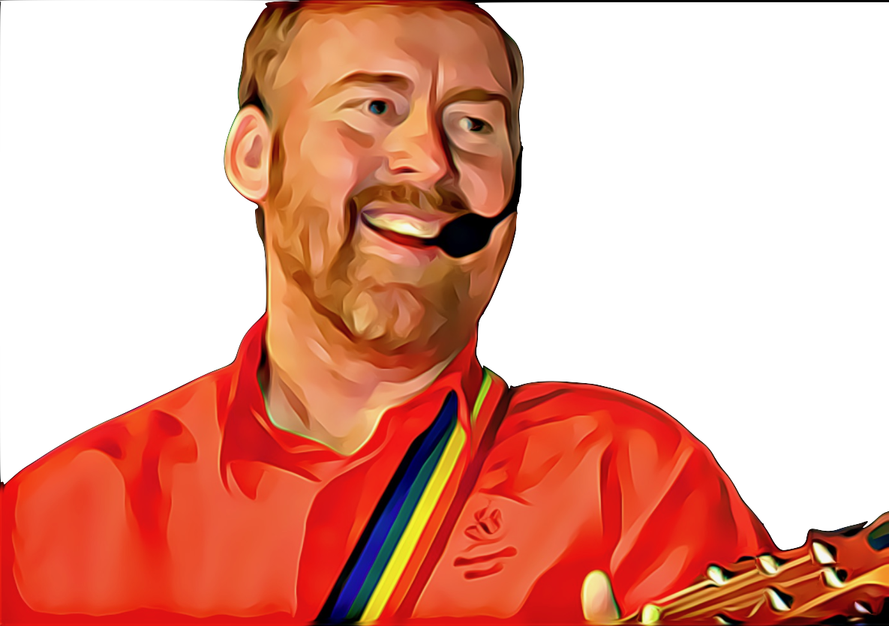


Hold My Hands
Composer unknown
Hold my hands, take my life
Lord I believe, Lord I receive
Into my heart (Come Lord Jesus)
Be my guide (show me the way)
For I’m just a child
with a great need for love
Here I come
All reasonable efforts have been made to contact copyright owners of this song.
Any further claim will be settled in good faith.

