Slide 1

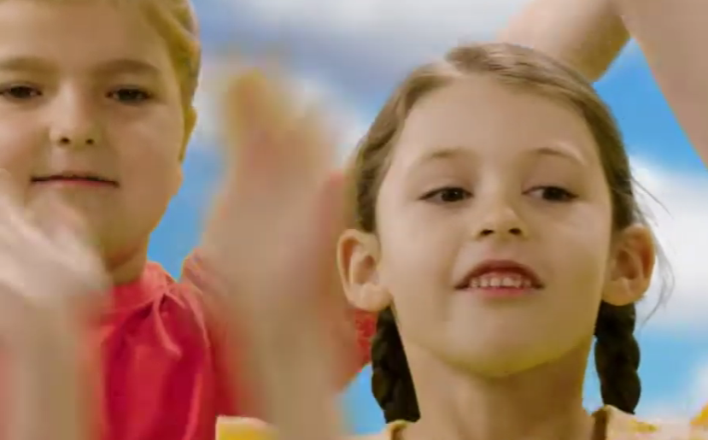


I Love And God Loves Me by Andrew Chinn
I love the warmth of the sun
And I Love a hug from mum
I love to jump and to run
These are the things that I love
And God loves me
© Andrew Chinn 2017

Slide 2
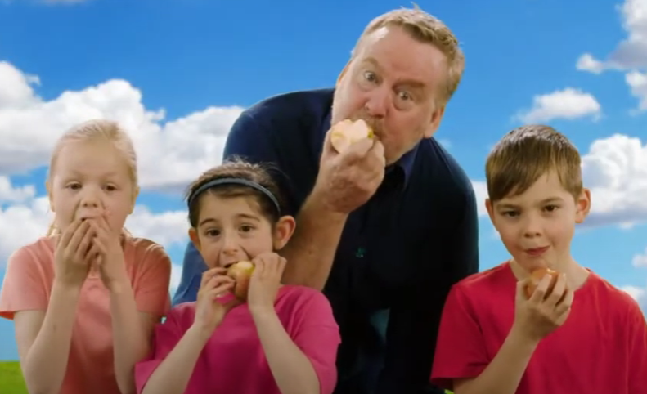
I Love And God Loves Me (2) by Andrew Chinn
I love an apple to crunch
And I love a carrot to munch
I love my sandwich for lunch
These are the things that I love
And God loves me
© Andrew Chinn 2017

Slide 3
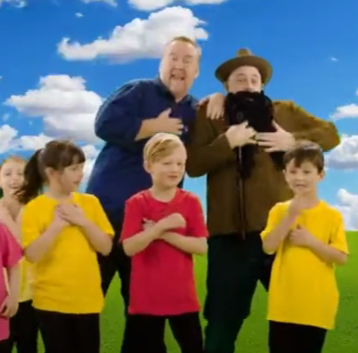
I Love And God Loves Me (3) by Andrew Chinn
I love to walk with my dad
And I love a kiss from my nan
I love to play with grandad
These are the things that I love
And God loves me
© Andrew Chinn 2017

Slide 4
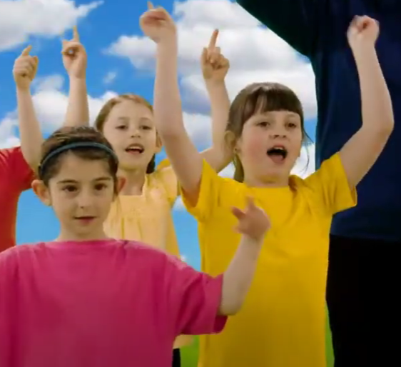
I Love And God Loves Me (4) by Andrew Chinn
I love to play with my dogs
And I love to sing happy songs
And I love it when you sing along
These are the things that I love
And God loves me
These are the things that I love
And God loves me
© Andrew Chinn 2017

